Slide 1




Training
Notes:
Insert Public Health Unit Logo here.

Slide 2

Land Acknowledgement Slide
(Optional)

Slide 3




Before we begin:
If you need support,
talk to a trusted adult
You can also connect with:
Kids Help Phone @ 1-800-668-6868
Connex Ontario –
phone, online support, chat
https://connexontario.ca/
Local youth supports:
to be added
YOU SHOULD KNOW
We have a duty to break your confidentiality if you tell us something and
  there’s a serious or immediate risk of harm
  there’s a suspicion of abuse or neglect
  if we are required to, by a legal proceeding
To learn more, search “duty to report Ontario”
Notes:
Include your school resources and some helplines on this slide.
Examples:
School resources:
Child and Youth Worker or Social worker
Nursing staff
Guidance counselor
Teacher and other trusted school personnel
Parent or other trusted adult (grandparent, coach, etc.)
ConnexOntario: Free 24/7 access to mental health and addictions services information. Call 1-866-531-2600, text CONNEX to 247247 or chat (connexontario.ca)
Drug and Alcohol Helpline: 1-800-565-8603
Kids Help Phone: Text CONNECT to 686868 or call 1-800-668-6868. If you identify as Indigenous, text FIRST NATIONS, INUIT or METIS to 686868.
Hope for Wellness Help Line: Available to all Indigenous people across Canada. Call 1-855-242-3310. Phone support is also available upon request in Cree, Ojibway and Inuktitut.
Trans Lifeline: A hotline staffed for transgender people experiencing a crisis. Call 877-330-6366.
Talk Suicide: 1-833-456-4566 available 24/7 or text 45645 between 4 p.m. and midnight ET.
LGBT Youthline Ontario: Call 647-694-4275 or youthline.ca (chat, text and email currently available)
“If you want support or simply want someone to talk to, here’s where you can go.”
3

Slide 4

Today’s Agenda
  Welcome and Agenda Overview
  Safer Space Guidelines
  Introductions
  Icebreaker activity
  What is YWC and Why are we here today?
  What’s in it for me?
  Mental Health Continuum
  Mental Health, Mental Illness & Stigma
  Substance Use
  Wellbeing
  Stigma – what is it? Why does it happen?
  Stress & Sources of Support

Slide 5









Trust the process
Pass option
Share the air -
Step up or step back
Respect the tech
Agree to disagree
Safe Space Guidelines
Support each other
Be open minded
Have fun and look after yourself!
Respect each other’s privacy
Notes:
We understand that you are experts in working with youth and creating safer spaces. In this presentation, we will give ideas on how you can apply your existing knowledge to the context of YCO and provide you with some guidance based on feedback from the youth.
We have included a framework for adult allies to develop a Safe Space Plan that can help support youth if they experience distress during training or meetings.
Key steps:
Pre-warning about and normalizing of sensitive topics (i.e., today we are going to be talking about substance use. Sometimes this can be difficult to talk about, but it is an important discussion. We encourage you to reach out for support if needed.).
Before the training begins, let youth know: “If at any time during the training, you are feeling uncomfortable, please let an Adult Ally know”.
Monitoring for signs that indicate participants may need support (e.g., being teary, becoming withdrawn) and pre-identify supports that are available to check-in with students who are struggling, such as the student’s guidance counsellor.
Using thumbs up or down code to let ‘safety’ person know you are ok if you have to leave (e.g., washroom).
Establishing a relaxation space or “chill zone” for students who may be triggered by content.
Enlisting the support of school board mental health professionals, community group mental health professional or public health nurses to participate in the training or workshop.
Offer counselling support if available and if the need arises.
Allowing students to opt out of participating in various activities.
Being aware of locally based resources for support including School board-based supports, community supports, Youth Services Bureau (YSB), etc.
Ensure that when Adult Allies discuss confidentiality, they also discuss the limits – that if a youth is in danger, they will have to tell another adult.
Youth have emphasized to us that they highly value privacy and confidentiality. It's crucial to discuss privacy and confidentiality limitations when creating group norms. Let the Peer Leaders know that if they inform you that they, or another youth, may be in danger, you'll need to tell another adult to ensure everyone's safety.
Ask the youth not to use names or any other identifying information when sharing stories. Remind them to respect their peers' privacy and not discuss any personal information they've learned unless there's a safety concern.
Invite youth to answer: Are there any other suggestions on how we can create a safer space for youth?

Slide 6
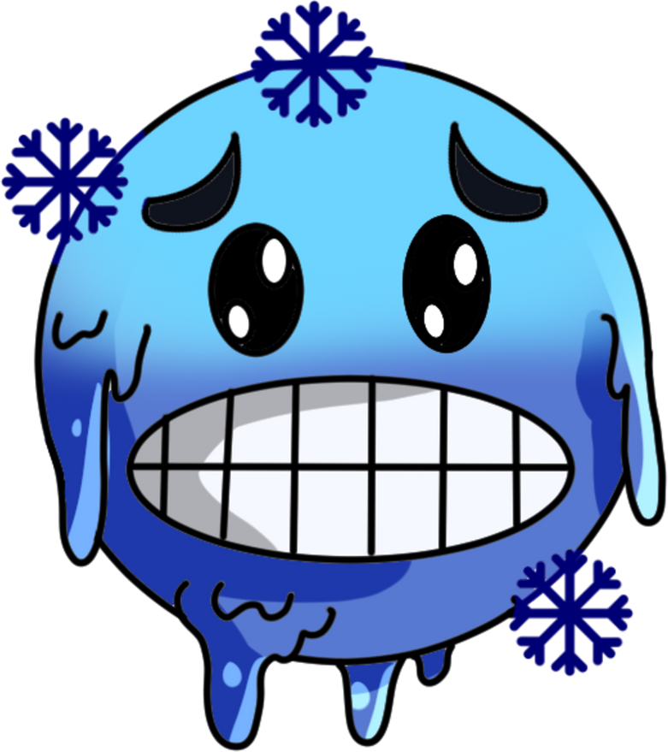
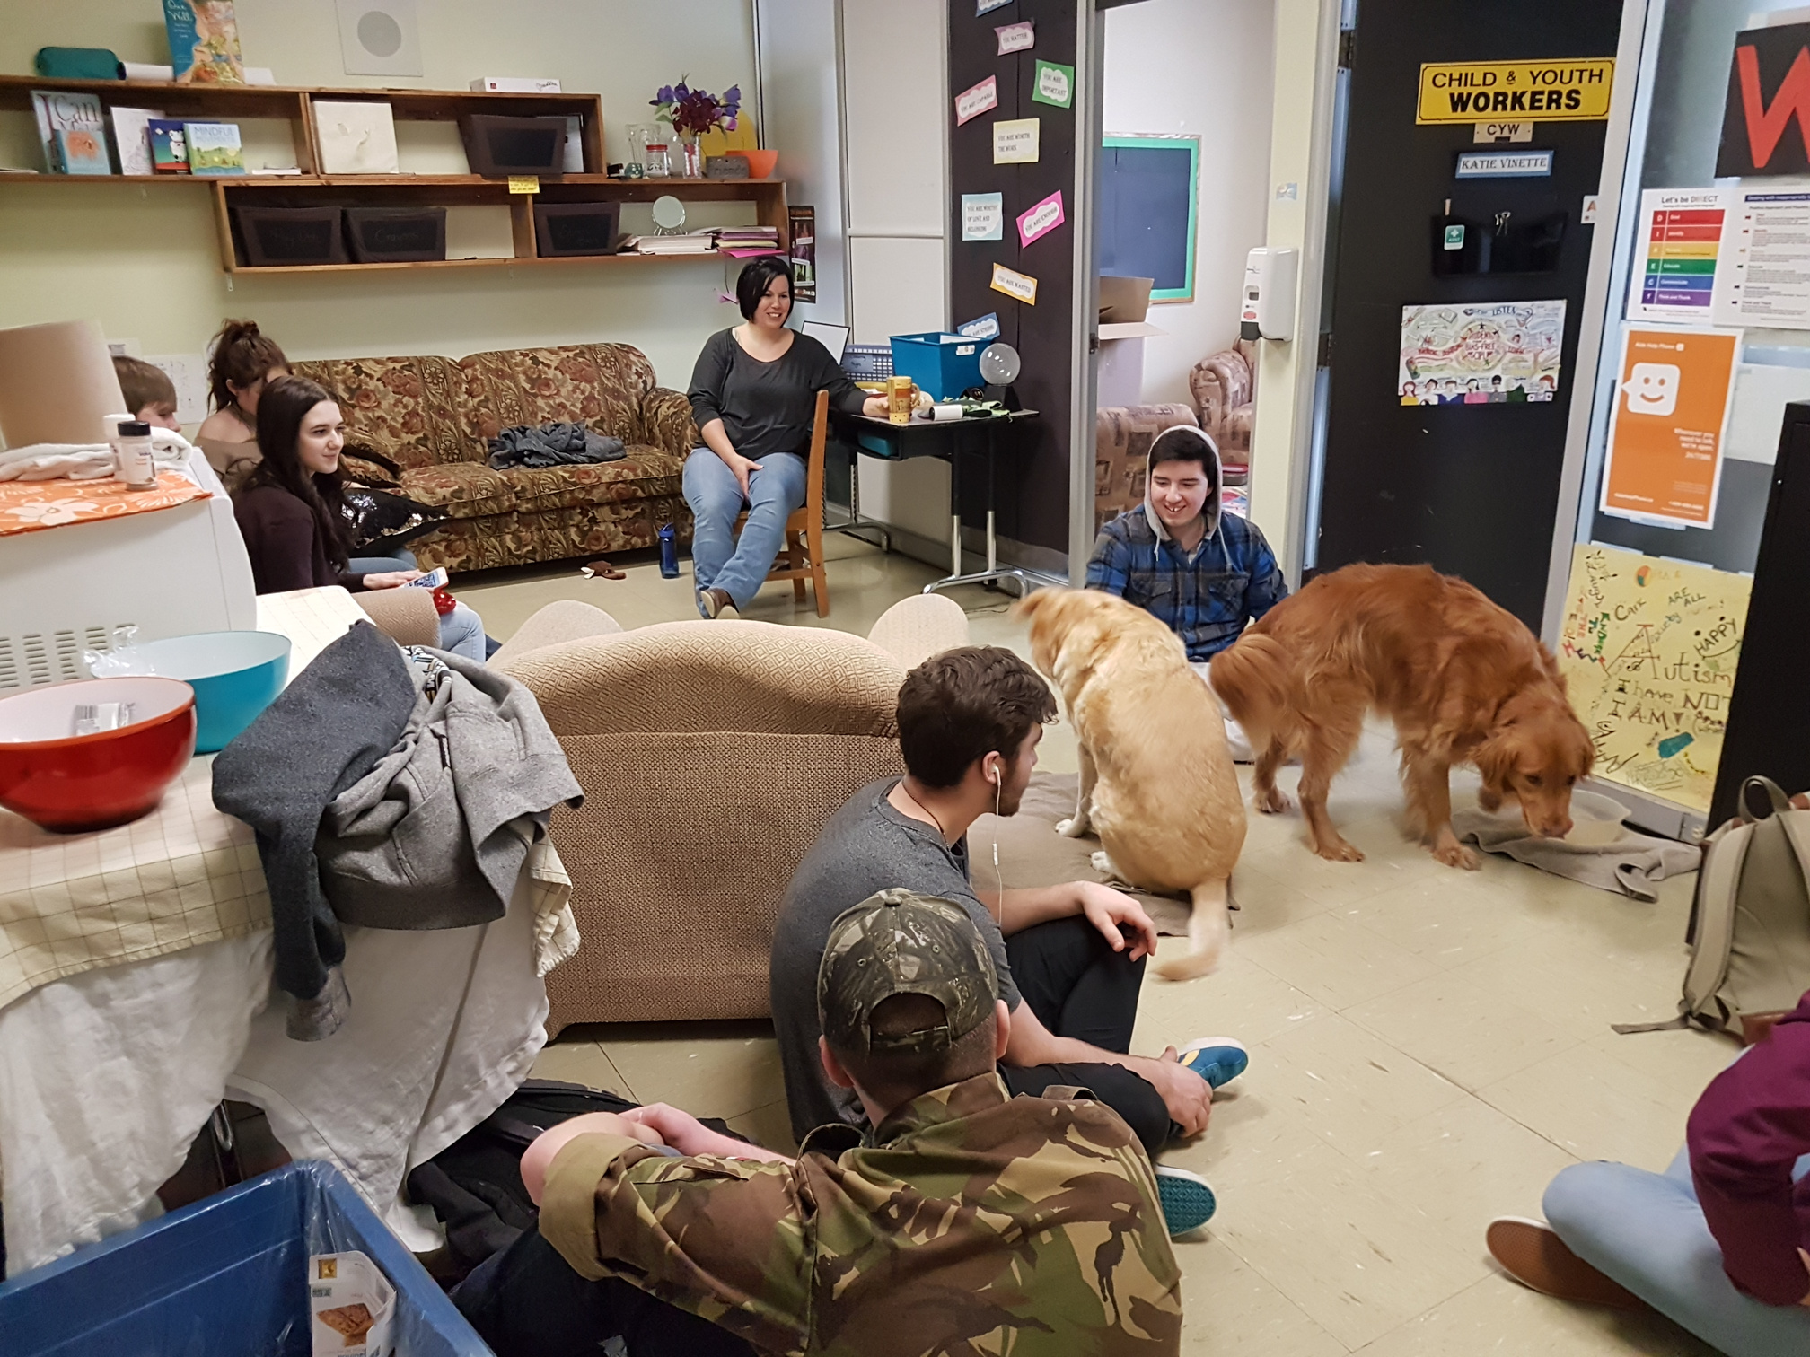
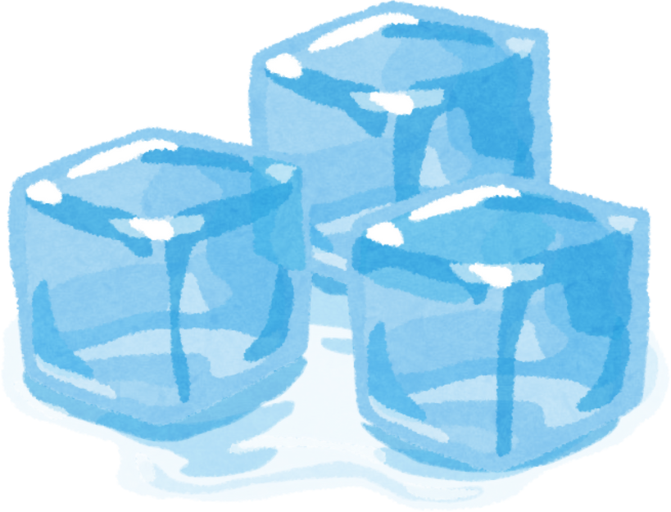

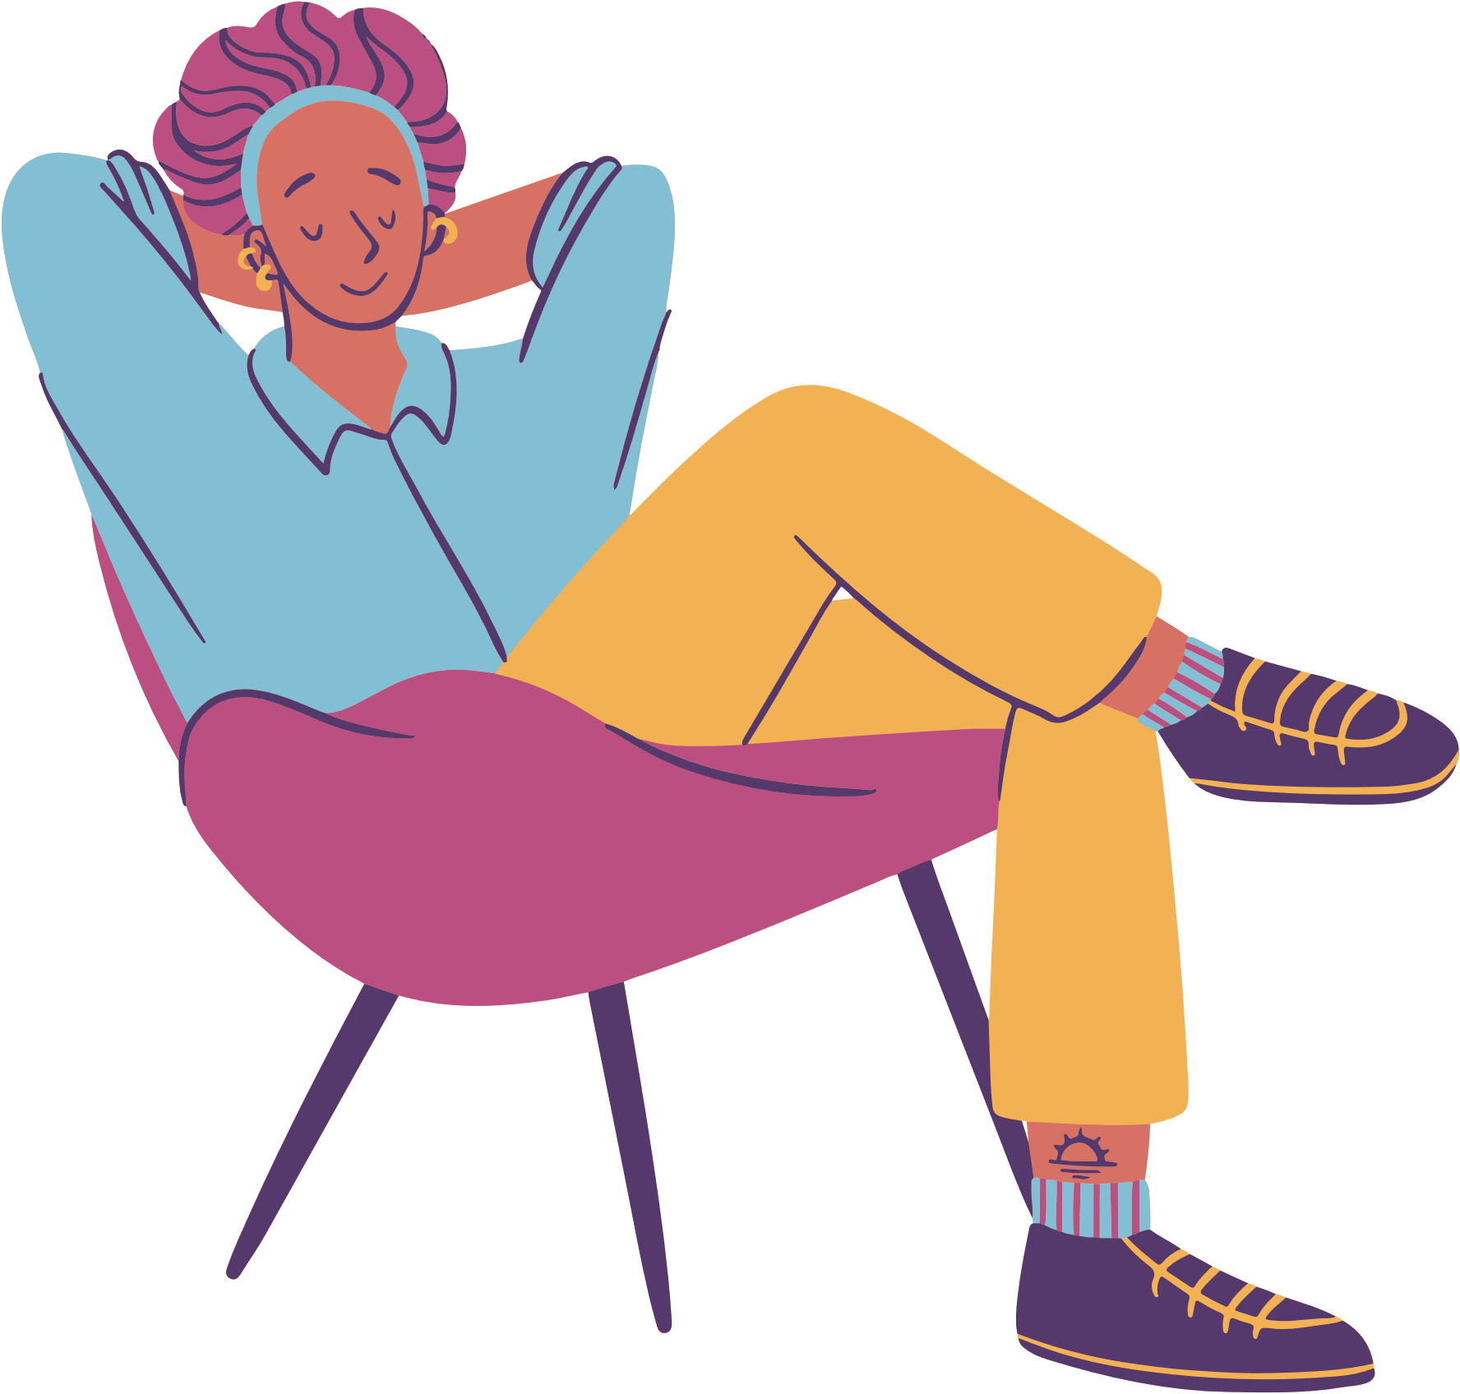

The
Zone
CHILL
Notes:
We also know that sometimes topics surrounding mental health can trigger overwhelming feelings at times so please if you need to leave the room for a reason other than feeling overwhelmed than make eye contact with one of us and give a thumbs up. Should you leave without doing this one of our team members will follow you to check in to make sure that you are alright.
If applicable:
Sometimes we all just need a break so we have created a chill zone (state where this is). This is a place to go if you just need some quiet or a break from the activities for a bit. Just let a team member know that you would like to use this space.
Local sites to add in locations and instructions on how to ensure safety
7

Slide 7

Introductions:
Who are we?

Slide 8
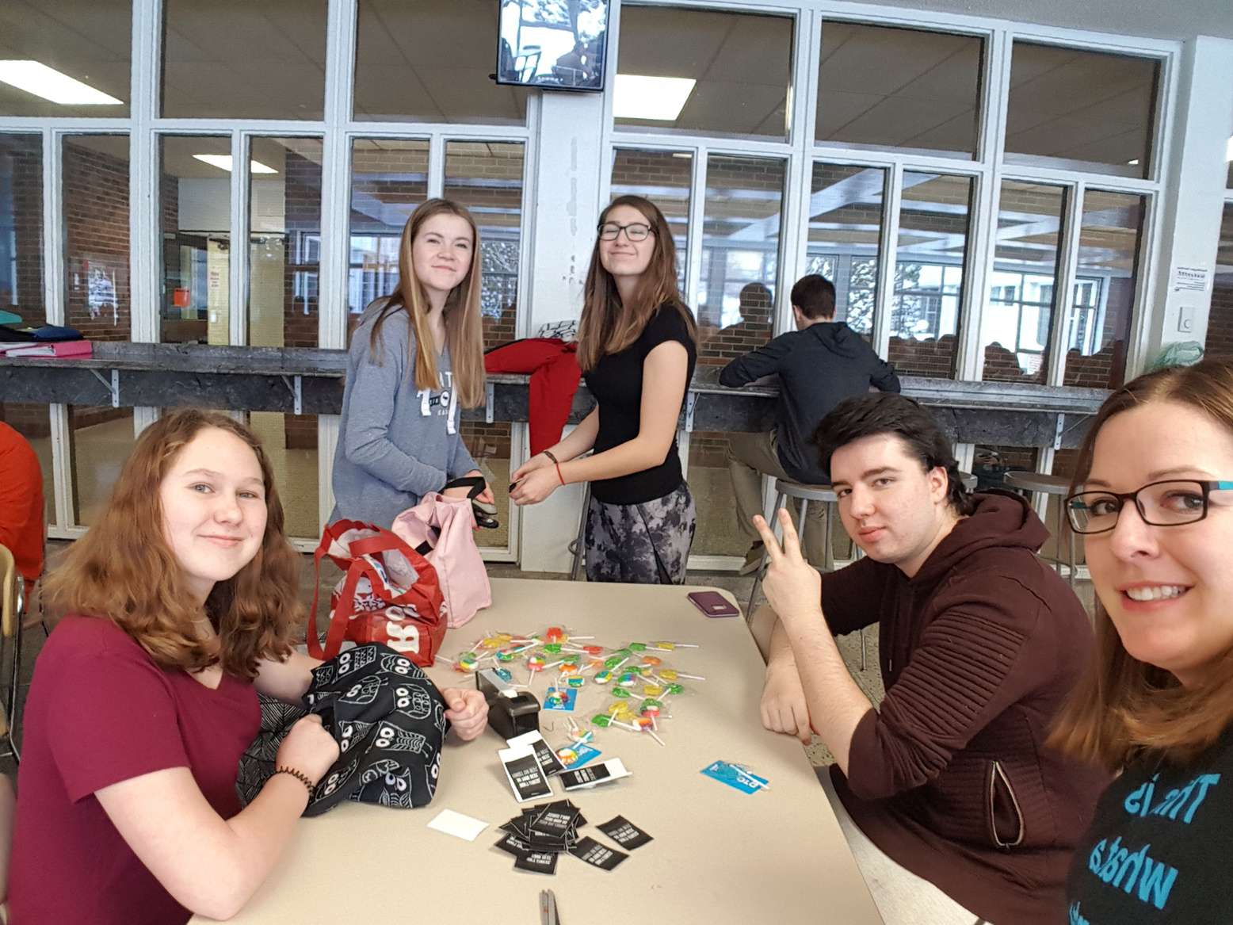


Icebreaker Activity
Notes:
Option 1:
Write your name and an interesting or fun fact about yourself on a piece of paper. 2. Crumple the paper into a ball. 3. Pass all the paper around the group until someone says “stop.” 4. Take turns reading out each paper until everyone has been introduced
Option 2:
Introductions….
Ice Breaker Game: Who are we?
Everyone is here because they were chosen or invited to be here today by an adult ally in your school or community group. Someone thought you would be a great peer leader who would be interested in positive mental health and substance use health promotion through the Youth Connections Ottawa Program. The objective of this training is to learn about Youth Connection Ottawa, what the program is and what could it look like in your school or youth group.
Directions:
Ask youth stand up in a circle facing each other, you will need a ball for this activity.
The individual holding the ball will state their name and one thing they are good at/like about themselves. (ex. My name is Max and I am good at basketball, my name is Aisha and I like that I can make people laugh).
Once an individual answers they will then pass the ball to another youth, that individual will answer the same question (or pass if they would not like to answer) and continue until everyone has introduced themselves to the group.
Option 3: The great wind blows Activity
Team Builder: Great Wind Blows Game:
This game gets people moving, helping to break the ice at the beginning, and mixes up the group. It is also a fun way to get to know interesting things about each other.
Directions:
Arrange all the chairs to form a circle (all chairs facing inward toward the middle). One player starts in the middle, standing up. They begin the round.
The person in the middle starts by saying “Great wind blows for everyone who…” and then says any characteristic that is true for themselves. For example, if the person has sung Karaoke before, they can say, “Great wind blows for everyone who has sung Karaoke” All players who have sung Karaoke before must stand and quickly find a new seat that is more than two chairs away from them.
If a player is not able to find a vacant seat, they are the new person who is in the middle.
Some ideas include:
Great wind blows for everyone who…
Hates chocolate.
Finds exam time stressful
Loves to wear a watch
Likes sushi
Uses sports to relax
Listens to K-Pop
Has ever needed help
Knows a tik tok dance
Has a pet
Whose favourite colour is green
Is interested in helping others with mental health and substance use health
Option 4: Many Balloons
Instruct the group to stand in a circle. Ask what mental health issues they think their peers are facing. As issues are identified, they are written on a new balloon and tossed into the group. The group has to keep the balloons in the air.
Prompts if needed: stress, jobs, parents, friends, sports, relationships, mental illness (anxiety, depression, bipolar, schizophrenia)
As more and more balloons are added, it becomes evident how difficult it can be to keep on top of all the things going on in their (and their peers) lives.
Key points for facilitator
Many students face mental health struggles or mental health problems
Keeping the balloons in the air was easier when everyone worked together
One person couldn’t keep all the balloons in the air. Requires the whole group to support the balloons.
Option 5: Identical and Different: If you’re a large group, split into teams of 4-6. Ask participants to find something that the group has in common (e.g., "everyone has been to the beach“, “everyone has a sibling”) and something that is unique to each person in the group (e.g., "plays waterpolo", "speaks Greek").
Option 6: Would you rather
Would you rather
Make a list of questions with two options. For example:
Eat a stick of margarine or 5 tablespoons of hot sauce?
Go skydiving or deep-sea diving?
Have legs as long as your fingers or fingers as long as your legs?
Live in a zombie apocalypse or alien invasion?
Laugh at sad things or cry at funny things?
Sand in your shorts or water in your ear?
Start school at noon, but have to stay until 8pm every day, or start school at 4am but be done by noon?
Have super strength or super speed?
Have the group stand in the middle of the room. Designate one side of the room as “option A” and the other side as “option B”. You can also designate the left arm as “option A” and the right arm as “option B”. Ask each question and ask participants to move to one side of the room (or lift the arm), depending on which option they “would rather”.
9

Slide 9

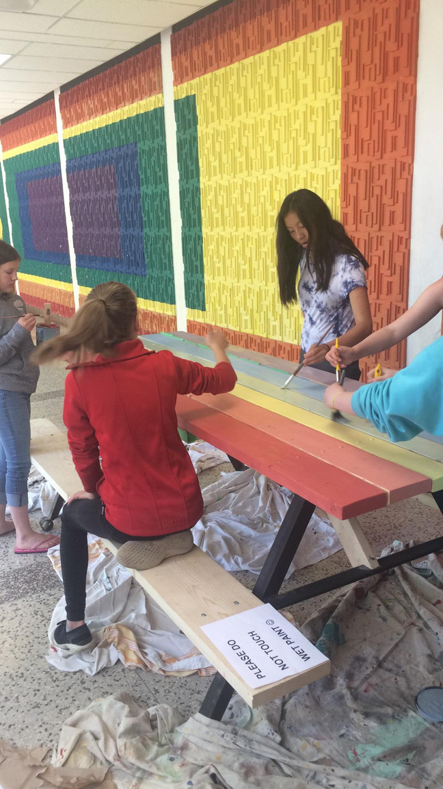
Youth Wellness Champions!
What is YWC?
  An innovative, peer-based program based on youth engagement principles
  Designed to help youth develop knowledge and skills they need to cope with mental health and substance use issues
  Supports students to become Mental Health Leaders and Champions in their schools and community.
  Partnership between the RNAO, Health and Education Systems in Ontario
Notes:
Sabrina
10

Slide 10



Why are we doing this work?
  Raise your awareness about Mental Health & Mental Health Promotion
  Support your overall well-being
  Decrease the stigma related to mental illness
  To develop your leadership and facilitation skills
Notes:
Goals of the program are to:
Promote mental health and wellbeing
Acceptance of mental illness
Reduce stigma
Substance use prevention
Increase awareness of in school resources and supports for mental health and wellbeing
11

Slide 11
Why are we doing this work?
  Raise youth awareness about Mental Health & Mental Health Promotion
  Support overall well-being of youth
  Decrease stigma related to mental illness
  To develop leadership and facilitation skills amongst youth
Notes:
Goals of the program are to:
Promote mental health and wellbeing
Acceptance of mental illness
Reduce stigma
Substance use prevention
Increase awareness of in school resources and supports for mental health and wellbeing
11

Slide 12
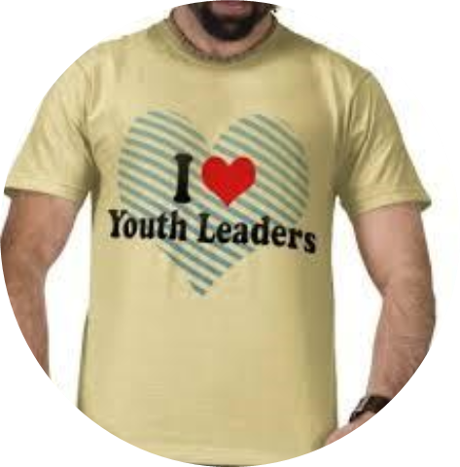

Who is involved?
  Registered Nurses Association of Ontario
  School Mental Health Ontario
  School Boards – Insert board
  Public Health Units – Insert health unit
  Community Partners
  # High Schools
  # Youth Wellness Champions per school
  # Adult Leads per school
Notes:
12

Slide 13









YWC Provincial Partners
Notes:
Sabrina
13

Slide 14


The
Youth Wellness Champions Program celebrates
10 years!
Notes:
sabrina
14

Slide 15



  school can be stressful!
  you spend most of your day here
Why promote mental health in schools or community?
  there’s lots of support in school
  staff can provide you with resources
  there’s opportunities and friendships
  YWC is linked with school curriculum
  everyone could use a bit of help!
Notes:
Stasia
16

Slide 16



attend a workshop
be a team player, come to meetings and answer group messages
What’s your role?
work together to plan an inspiring activity
celebrate your success and
have fun!
Notes:
Youth champions – plan and lead activities that share knowledge with your peers and promotes positive mental health and substance use health
“Our role as a group is to think about new ideas and ways to promote mental health & well-being in the school or community and make an action plan.”
Student expectations (all of you):
Attend a workshop – CONGRATS, you are doing it!
Attend group meetings. Your involvement is crucial! You know your peers best and what they need for their wellbeing. We’ll decide on meeting dates, times and frequency (weekly or biweekly) at the end of the workshop.
Work together to plan, implement and evaluate at least 1 activity in our school or community. The evaluation doesn’t need to be complicated. It’ll help us see if we reached our desired goal and how we can make it better next time around.
You’ll have the option to take on specific roles (ex: photographer, public speaker, decorator, graphic designer, etc.)
Your adult allies will support you to develop ideas and events that you will find fun and that will be most helpful to your own communities.
School Staff Champion / Adult ally:
We will help you with action planning and implementing the activities/initiatives.
We will help take care of the logistics and get approval of action plans.
We will also send meeting reminders and support you between the meeting times.
“I do want to be clear that although we’ll be talking about different types of mental illnesses or symptoms of mental illness, it is NOT your responsibility to diagnose your peers or provide counseling. As Champions in schools, you may be asked by peers for help with their mental health problems, but again, this is not your role. What you can do is share resources and support your peers by helping them find someone to talk to. Your teachers, your guidance counsellors, your principals, and VPs are always there to help students when they need more support. And our school has professionals like CYW (name) and mental health workers (name) to provide support to students when they are in crisis.”
Your role as a Youth Champion is to find ways to promote mentla health and wellbeing in your school environment!
17

Slide 17




What’s in it for me?
you’ll gain skills in:
  public speaking
  communication
  leadership
  advocacy
you’ll learn how to:
  talk about mental health and substance use health
  promote mental health and substance use health
  build resilience and coping skills
  connect with supports in your community
you’ll get to:
  meet new people
  plan and lead events and activities
  promote wellness in your community

Slide 18
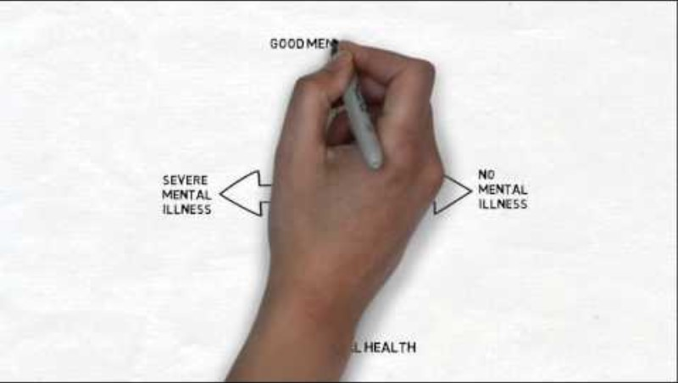
What is Mental Health?
Video
Notes:
Sample Video: Watch “Promoting Mental Health –Finding a Shared Language” CAMH Health Promotion Resource Centre (Do it. Yourself.)
The video talked about how mental illness and mental health are two separate things, but they also relate to each other. The way they relate to each other is through what is called a continuum. In a continuum, you do not say that a person only has mental illness or only is mentally well. A person can have mental illness, but have it managed and be mentally well. While another person may not have a mental illness, but they may not be able to manage all the stress and pressures of life which puts them in a state where they are not mentally well.
Things in our lives, including school can cause stress and anxiety, and this can affect our mental wellness. It is important that we create an environment that supports good mental health for all.
Since you spend a lot of your day in school, your involvement with the YWC project will help you learn how you can promote mental wellness in your school. Before you plan activities to promote mental wellness in your school, we need to understand the mental health continuum
19

Slide 19


The Mental Health Continuum
Good Mental Health
Severe Mental Illness
Good mental health with severe mental illness
Good mental health with no mental illness
Poor mental health with severe mental illness
Poor mental health with no mental illness
No Mental Illness
Poor Mental Health
Notes:
Mental health and mental illness are not opposing conditions. Someone with a diagnosed mental illness can experience good mental health, while someone without a diagnosed mental illness can experience poor mental health (MHCC, 2009).
Reference: Mental Health Commission of Canada (MHCC). (n.d.) Retrieved from: https://mentalhealthcommission.ca
Mental health is a continuum that is constantly changing. A person can have good or poor mental health, and this can change daily.
Mental health is more than the absence of mental illness. In the video they talked about how mental illness and mental health are two separate things, but they also relate to each other through a continuum.
Each person will fall somewhere on this spectrum and will likely move along the lines of being mentally healthy or unhealthy throughout their lives. Stressors and triggers you encounter during your life will impact where you are located on the scale at that given point in time. For example, a person who has a mental illness, who has great coping strategies and a good support system can also have good mental health. On the other hand, a person without a mental illness can actually have poor mental health if they are experiencing challenges and stressors that are preventing them from coping.
In a continuum, a person may not have a mental illness but are unable to cope with all the stress and pressures of life which puts them in a state where they are not mentally well. While another person can live with a mental illness and have it managed and be mentally well. Similar to someone with a physical illness, like diabetes. They can manage it with the right supports and treatment, feel well and experience good physical health, despite having an illness. The same is true for someone living with depression. If they have what they need to manage their illness, they may also feel mentally well and experience a good quality of life. That’s why getting treatment and support is essential.
This model shows that we can ALL strive for good mental health.
20

Slide 20

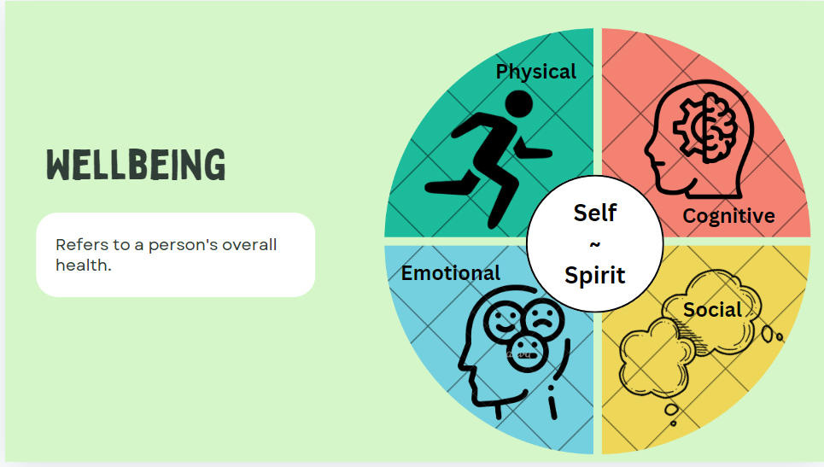
What’s mental health
What is
mental health?
“Mental Health is a state of well-being in which the individual realizes his or her own abilities, can cope with the normal stresses of life, can work productively and fruitfully, and is able to contribute to his or her community”
– World Health Organization
Notes:
Optional activity before diving into the content: Ask students what mental health means to them and write their answers on a flipchart.
“Mental health is an essential component of health. Each of us has mental health, just as we have physical health. But where physical health refers to our bodies, mental health refers to our thoughts, feelings, behaviours.”
“Good mental health doesn’t mean you feel happy and confident 100% of the time or that you don’t experience different emotions. You’re in a state where you generally feel good, can cope well with life's challenges and able to function.”
“People with good mental health can:
make choices and decisions;
adapt and cope with daily challenges;
know how to recognize, understand and deal with emotions;
enjoy life and learn to live "in the moment".
know and accept strengths and weaknesses;
perform well at school and work;
maintain relationships;
accept yourself;
set realistic goals for yourself.”
Mental health:
“Mental health is a state of mental well-being that enables people to cope with the stresses of life, realize their abilities, learn well and work well, and contribute to their community,” (WHO, 2022).
Positive Mental Health: Is a state of well-being that allows us to feel, think and act in ways that enhance our ability to enjoy life and deal with the challenges we face – Public Health Agency of Canada, 2018
References:
Mental health (World Health Organization, 2025)
21

Slide 21





What’s mental health
What is
mental illness?
substance-related
anxiety
  Mental illness is defined by changes in thinking, mood or behavior that impact day to day functioning
  Can affect people of any ages, any gender or any race
  Often appears in teenage years or early adulthood (Public Health Agency of Canada, 2015)
  There are many different types of mental illnesses
  1 in 5 people will experience a mental illness some point in their life
psychotic
eating
personality
Notes:
“We ALL feel stressed, sad, or worried at times or may struggle, and that’s ok… and normal! This is when you get some support and do a little extra self-care to start feeling well again. Kinda like drinking water, getting some rest, or avoiding spicy foods if you have a stomach ache. It becomes worrisome when your struggles become intense, long lasting and are having a notable impact on your everyday life. This is when you should get extra support from a professional or care provider.”
“Mental illness however can affect anyone regardless of your age, gender, income, race, culture, etc.”
“Ways that a mental illness can affect a person:
Interferes with the person’s ability to do normal social activities or daily tasks, like being with friends, going to school, work.
Affects the person’s level of enjoyment – may not enjoy the things that used to bring them joy and happiness.
Difficulty coping with challenges of everyday life”
“Mental illnesses are diagnosable by a mental health professional. Some examples include depression, bipolar disorder, anxiety disorders, eating disorders, psychosis, and schizophrenia. Again, mental illness, like physical illness, can be treated effectively. A diagnosis can help the individual get the right treatment.”
How diagnosed: A diagnosis is based on a person’s subjective and personal symptoms, and the signs that physicians or relatives notice. For people working in the mental health field, having definitions of disorders is helpful when describing a mental health problem. The Diagnostic and Statistical Manual of Mental Disorders (5th edition; APA, 2013), also called the DSM-5, categorizes mental health disorders and offers examples of signs and symptoms of mental health problems.
There are different types of mental illnesses. People of different ages, from different backgrounds may have a mental illness at some point in their life
Extra video if needed to describe Mental Illness (Obsessive Compulsive Disorder): https://youtu.be/2i6tzC2YbDI?si=ltd6vkLlwEhKbC3O
22

Slide 22

Hands Up for Mental Health!
Activity
Notes:
Activity option1: This activity will examine common misconceptions about mental health and mental illness. Encouraging the group to close their eyes or to not look at each other will ensure more honest answers.
This activity also provides an opportunity to have a discussion about the different ideas brought up with each question. There are key messages to help you to facilitate this discussion at the end of the worksheet.
Directions:
Ask youth to sit either facing away from the group or with their eyes closed.
Explain you will read out a statement and with their eyes closed or without looking at the rest of the group vote whether the statement being read is true or false.
Using a show of hands, count the results and note them on the flip chart.
Ask students to share some general observations about the group’s results. Facilitate a group-wide discussion about the survey results, highlighting items that may be surprising.
Most people will never be affected by mental illness.
False
Mental illness is diagnosable illness that affects our thoughts, feelings and actions. In Canada, one in five people will experience a mental illness in any given year. For this reason, most people are affected by mental illness, either directly (by having a mental illness themselves) or indirectly (by knowing someone with a mental illness).
2. We have some control over our mental health.
True
Mental health is a state of well-being where a person realizes their own potential, can cope with the normal stresses of life, can work productively, and is able to contribute to the community. Although we cannot always control what happens to us, we have some control over how we react.
Some ways we can take control of mental health include:
Taking care of our health;
Acknowledging our feelings are normal;
Developing positive and realistic ways of thinking about ourselves and the world around us;
Talking to others we trust about our mental health;
Making sure we have a network of friends and family for support; and,
Reaching out for help when we are struggling.
3. People with mental health challenges should deal with it on their own.
False
When people are having trouble with their physical health, they often go to the doctor or ask others for help. Mental health challenges can be related to how the brain is working, and often it is important to get help from a professional. Unfortunately, because of stigma, many people do not ask for help.
4. People do not recover from mental health problems.
False
Like any health problem, people recover from mental health problems. It is important, though, to get the proper help. Sometimes people need the help of a counsellor, a social worker, a physician, a psychologist or a psychiatrist in their recovery. They also need the help and support of friends and family, as well as the understanding of co-workers or classmates.
Sometimes embarrassment stops people from getting the help they need. Many people experience a mental health problem in their lives, but with help are able to recover and have full, happy lives.
5. Being a good friend can sometimes mean breaking a promise to make sure a friend gets help.
True
Sometimes it is essential to break a promise to ensure that a friend gets the support they need. A friend may tell you they are feeling “bad” or want to hurt themselves. They may even tell you they are thinking about suicide. When friends struggle, they often require more support than a friend can provide. To keep them safe and to get the help they need, it is important you share this information with an adult you trust.
6. Positive coping strategies can help us deal with life's stressors.
True
Positive coping describes the things you do that:
Help you to feel better
Respects others and property
Helps you to solve the problem
Positive coping strategies help us to feel more balanced and able to cope with stress. They help us:
Learn to accept your feelings.
Find ways to relax and calm overwhelming feelings.
Think and problem solve challenges in more realistic and positive ways.
7. The way we listen and talk to our friends shows we care and makes them feel safe to share their concerns.
True
Listening and acknowledging people’s feelings and thoughts shows you accept them and care about their mental health and well-being. You can help them feel safe to talk and get the help they need.
8. Talking to ourselves in a positive way can help us get through life's struggles.
True
Self-talk is our inner voice that affects how we feel and behave. Positive self-talk involves talking to yourself in a way that is compassionate and understanding. It-takes practice to learn this strategy. In a tough situation self-talk can help you think in positive, realistic ways. It helps problem solve challenges and try new ideas. For example, when you fail a test tell yourself, “Failing is upsetting, so I feel disappointed and that’s okay. I can change things. I will talk to my teacher and ask for help, give myse

Slide 23


Brainstorm!
What is...
mental illness?
mental health?
wellbeing?
Notes:
Activity Option 2:
Youth get into groups of 4 – 5
Each get a chart paper and have to address the following questions:
What is Mental Health
What is Mental Illness
What is wellbeing
Group discussion:
Why are these important?
How can our role as Youth champions help
24

Slide 24


Our Wellbeing Statement
Notes:
Activity Option 3:
Well-being: is a combination of a person's physical, mental, emotional and social health.
Supplies:
Ball of yarn
Activity:
Ask youth to sit in a circle.
Toss a ball of yarn from one person to another. Each time a person "catches" the ball of yarn they give an example of what wellness means to them. Continue until all have had an opportunity to participate, creating a 'web of wellness"
As a large group, or in smaller groups....
Brainstorm a well being statement, or model for their group.
A well-being statement will become the motto of the group and will help to encapsulate their goals. The well-being statement is a message about what the YCO group hopes to achieve.
You can use this time to brainstorm with the Peer Leaders and Adult Allies. Have them discuss as a group what they would like to achieve from the YCO group within their school or community.
From the brainstorm you can work together to come up with a well-being statement that represents their YCO group. Use the examples and key messages below to help guide your conversation.
Examples:
Look, Listen, Link
Breaking codes of silence
Agents of change
Key messages:
Health promotion is about taking action to strengthen the health of all.
By working to increase people's self-esteem, coping skills, social connectedness and well-being, health promotion empowers people and communities in ways that enhance emotional and spiritual strength.
Health promotion fosters individual and community resilience

Slide 25

  Mental Health is a positive concept
  Mental health and mental illness are two different things, but they are related
  We all have mental health, just like we have physical health
  Just like we need to take care of our physical health, we need to take care of our mental health
Mental Health, Mental Illness and wellbeing...
What’s the difference?
Notes:
Summary slide from Activity
26

Slide 26
  The communities where we live, go to school and play have an impact on our mental health
  We will all experience the ups and downs of life
  Asking for help can be difficult but it is a sign of strength – we all need help at different points in life
  People can have mental illness and still have good mental health. People can have no mental illness and still have poor mental health
Mental Health, Mental Illness and wellbeing...
What’s the difference?
Notes:
Summary slide from Activity
26

Slide 27

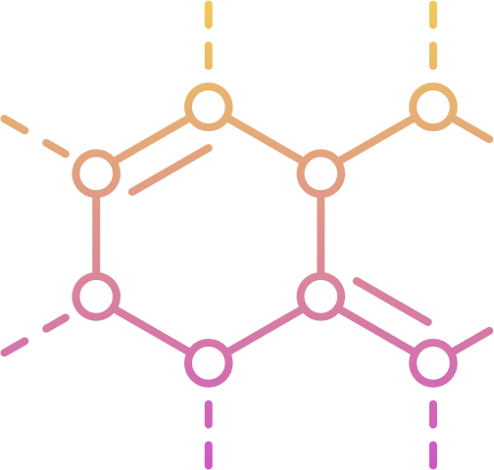
A substance is a chemical that has psychoactive properties (e.g., alcohol, tobacco, cannabis and other drugs) that can be used for medical, religious or ceremonial purposes, for personal enjoyment or pleasure, or to deal with stress, trauma or pain.
(Health Canada, 2023)
What is a substance?
Notes:
A substance is a chemical that has psychoactive properties (e.g., alcohol, tobacco, cannabis and other drugs) that can be used for medical, religious or ceremonial purposes, for personal enjoyment or pleasure, or to deal with stress, trauma or pain (Health Canada, 2023).
There are four categories of substances: hallucinogens, depressants, stimulants and anabolic steroids.
Substances can be legal or illegal and have the potential to be used safely and not become problematic. However, there is the potential for the drug to be misused, leading to a substance use disorder (RNAO, 2015)
27

Slide 28
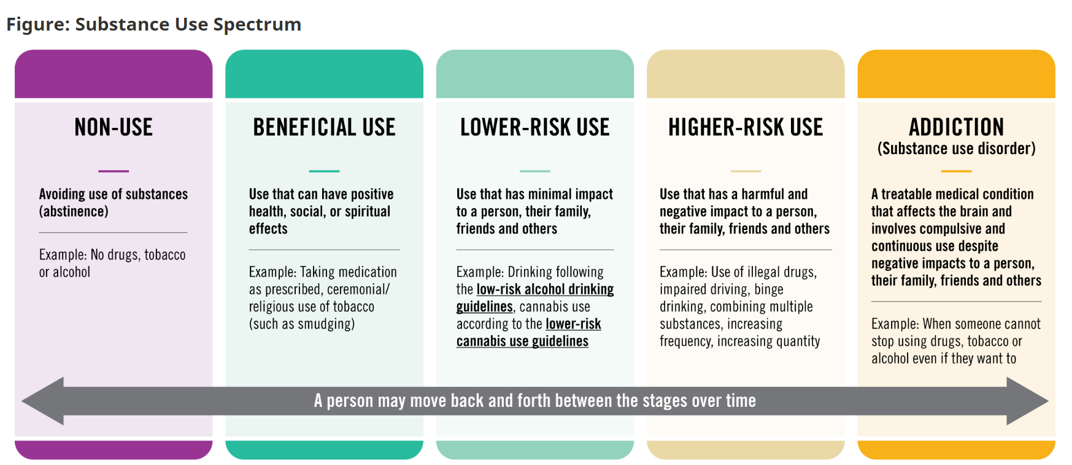
The Spectrum of Substance Use
Notes:
Substance use can be viewed on a spectrum, with varying stages of benefits and harms.
Stages of substance use include non-use, beneficial use, lower-risk use, higher-risk use and substance use disorders (Health Canada, 2022 or CPHA, 2024). Not all substance use will result in problematic behaviour or effects; however, in certain situations and depending on the type of substances consumed, substance use may lead to physical and psychological health problems in individuals, regardless of their socio-economic status or their geographical location (RNAO, 2015).
The spectrum is not linear or meant to be read as a process where a person progresses from one stage to the next. A person may move between different stages throughout their lifetime. It’s important to remember that well-being can happen at any point on the spectrum and can look different for each person—those who use substances and those who do not. Anyone should be able to identify themselves within the spectrum on any given day.
Individuals on this spectrum may move back and forth along the continuum/spectrum or be at different stages for different substances over time (Health Canada, 2022). The spectrum is not linear, meaning an individual may remain in one stage of this spectrum for years and never progress to higher risk use or substance use disorder (CPHA, 2024).
On the other end of the spectrum – is Substance Use Disorder, in accordance with the DSM–5, is defined as “a cluster of cognitive, behavioral, and physiological symptoms indicating that the individual continues using the substance despite significant substance related problems” (APA, 2013).
Individuals who have this diagnosed condition, continue to use substances, despite the high risk or actual harm.
Like other chronic medical conditions, there are many complex health and social factors that contribute to the development of Substance Use Disorders. It is important to acknowledge this and to treat challenges with substance use as we would any other health or medical condition. Hope and compassion go a long way in supporting and encouraging those who are struggling.
28

Slide 29
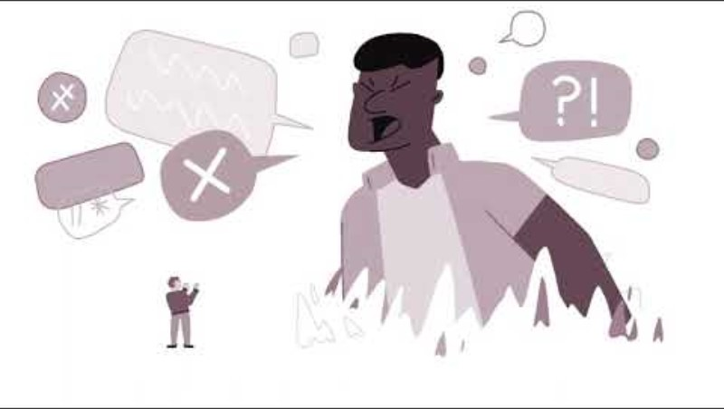
My journey begins with compassion
Video
Notes:
Activity Option 1:
Watch the video My Journey Begins with Compassion from CCSA: https://www.youtube.com/watch?v=RD0EOwWK8gI
2 min video
This video will encourage the group to think about the impacts of substance use stigma, and how stigma can create barriers to recovery and wellness. It can also prompt conversation on how to support individuals who have problems occurring with their substance use.
What did the video make you think or feel?
It is important to remind youth that people may choose to use substances, but no one chooses to have problems with their substance use or a substance use disorder. It is important to acknowledge this and to treat challenges with substance use as we would any other health or medical condition, and to reflect on personal bias related to people who use substances. Stigma can be reinforced, or prevented, depending on the words we use.

Slide 30


Discussion:
Substance Use Health
  How might you support a friend or loved one experiencing problems with their substance use?
  How can people challenge stigma and discrimination towards people who use substances?
Notes:
Activity Option 2: Substance Use Health
The purpose of this activity is to help peer leaders discuss substance use health and understand that substance use falls on a spectrum. It is important to have youth think about their own experiences with substances and understand that everyone falls somewhere on the spectrum, and that there are many different reasons why someone may choose to use substances.
Supplies required:
Large notepads
Coloured markers
Masking tape or painters tape
Directions
Split youth into groups of 4-5 (depending on the number of participants).
Handout large notepads to groups, ask youth to jot down their responses to the questions presented on the slide.
After groups finish writing down their thoughts, place the posters in an area that is visible to everyone.
Come together as a large group to discuss common responses and themes (there is information below that will support the facilitator).
Ask youth:
How might you support a friend or loved one experiencing problems with their substance use?
How can people challenge stigma and discrimination towards people who use substances?
Possible Responses/ Key Messages:
Remember, you do not have to have all the answers, your goal is to listen and allow the person to feel heard and to try to connect them to support from others. Sometimes a person may not realize there are problems occurring with their substance use. Talking to them can help and may be the encouragement they need to seek help. Starting the conversation can be tough or uncomfortable, but there are ways you can show that you care. Be aware that the conversation might bring out strong emotions and may not go as you expect, and that is okay. If you find yourself having difficulty with this, see Tips for talking about Substance Use (ottawapublichealth.ca).
To get help for yourself, a friend, or someone you care about, it is important to remember everyone has different goals related to their substance use health, and to support your friends and loved ones wherever they fall on the spectrum. Some helpful tips include:
Say what you notice without judgment, and remain open-minded and supportive
Remember to speak kindly and compassionately
Encourage safer or lower-risk behaviours and choices
Role model that you have asked for help in the past, from a counsellor or from an adult.
Ask if they might like to talk to someone for more information.
Encourage your friend or loved one to call, visit or read information online. If you want to refer someone to a resource and don’t know how, or maybe the person begins to tell you things that are difficult to respond to, you can shift the conversation by saying something like “what you’re going through sounds like it’s difficult to manage on your own. I know someone or an organization that can help. Can I connect you with them?”. You can even offer to go with them as support if they are nervous to go alone
B. Stigma is any negative attitude, belief or behaviour that discriminates against people. Stigma is one of the biggest barriers stopping those experiencing challenges with their substance use from getting help, receiving care, or even telling those closest to them they are struggling. Some ways to help reduce stigma and discrimination related to substance use health include:
Correct misinformation about substance use or people who use substances when you hear it, or direct people to resources that have the correct information
Be compassionate and understanding, and encourage others to do the same
Use de-stigmatizing and person- first language (see Appendix 5 for more details)
Research if there are organizations/groups in your area that center the voices and experiences of people who use substances for opportunities to learn more about substance use health
Advocate for policy changes that de-stigmatize substance use and focus on the lived and living experience of people who use substances
Continue to learn about substance use health

Slide 31
“I’d be better off with a brain tumor.
That way, you wouldn’t put off getting me the help that I need. You’d understand that my condition is only going to get worse, and not to hope that it will go away by itself. If I had a brain tumor, you’d understand I need treatment, not indifference.”
Partnership to End Addiction
Stigma

Slide 32
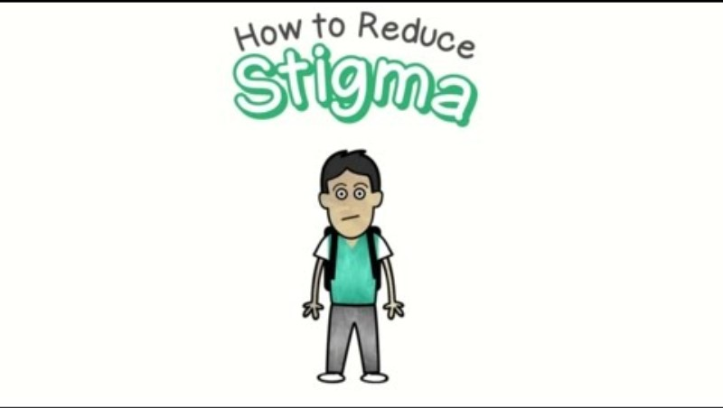

Stigma
Notes:
Video # 2 What if we talked about physical health in the way we talk about mental health?

Slide 33

Discussion:
Stigma
  What is stigma?
  Have you ever experienced a time in your life when you felt different?
  How did it feel?
Notes:
Group Discussion Questions (See above slide)
Additional questions for discussion:
Why do you think individuals living with mental illness are stigmatized? Why do you think people experiencing challenges with their substance use are stigmatized?
Are there any other health conditions or social issues that you can think of that are stigmatized?
How do you think stigma impacts the lives of people who are experiencing mental illness or mental health challenges? What about people who are experiencing challenges with their substance use or a substance use disorder?
What could people do to change the public's views and attitudes towards people experiencing mental health challenges or mental illness? What about people experiencing challenges with their substance use or a substance use disorder?
Possible participant answers:
Stigma can be: negative attitudes, being mean to people, treating other people poorly, hurting other people all because of their mental illness and the misconceptions around it
Feelings related to stigma could be: isolated, shame, guilt, overwhelmed, afraid for safety, not able to do usual activities, fear of judgement, not knowing where to get help
Things like movies, TV shows, and stories in the news or on social media that depict people experiencing mental illness as violent may influence how people think about mental illness. People with mental illnesses may sometimes act differently and others could fear things they don’t understand
Addictions and substance use, HIV/AIDS, weight, the 2SLGBTQ+ community
People may decide not to get help even if it could help them feel better, they may feel lonely, or it may prevent people from telling friends and family that they are struggling
Education, policy changes, campaigns, changing social norms

Slide 34
  Stigma is a negative set of beliefs about a group of people
  These beliefs can cause people to fear, reject, avoid and discriminate against others due to their attributes, traits, circumstances and even disorders
  People can experience stigma for a variety of reasons: gender, race, sexuality, age, illness
  The worry about being stigmatized may cause people to hide their symptoms or struggles, leading to poor health outcomes
Stigma
Notes:
“Stigma refers to a set of negative attitudes and behaviours towards people experiencing a mental illness. This can cause a person to be mislabeled and treated unfairly. Here are some common examples of stigma related to mental illness.”
Excluded them from activities.
Using harmful language, such as “crazy” or “insane”.
Avoid people with certain mental health conditions.
Saying things like “They could get better if they just had a decent amount of sleep and exercised.” or
“They’re just looking for attention.”
“Stigma can stop people from getting the help they need! People who have a mental health problem, or think they do, may feel embarrassed or unwilling to talk about it. They may fear being judged by friends, family, or others. Stigma can also lead to them to feeling hopeless and lonely.”
Ask the class why they think mental illness is stigmatized?
Media: Exposure to media stories that present people with mental illness as violent, criminal, dangerous, incompetent, and fundamentally different from other people.
Silence: One powerful way stigma is often expressed is through silence. Not talking about mental health can stop us from reaching out when we are struggling and may even prevent us from supporting someone we care about.
Lack of understanding or fear: Negative feelings or judgements about mental illness can be the result of not understanding.
“We have made some progress in reducing stigma, but we still have a long way to go.”
Watch video https://youtu.be/eio-I8PbdDk
Activity after video:
Ask participants to share what they saw, felt and heard.
Suggested questions to stimulate discussion:
What is stigma?
Have you experienced a time in your life when you felt different? How did it feel?
Why do you think individuals living with mental illness are stigmatized?
Are there any other social issues or health conditions that you can think of that are stigmatized?
How do you think stigma impacts the lives of people who are experiencing mental illness or mental health challenges?
What could people do to change the public’s view and attitudes towards people experiencing mental health challenges or mental illness?
34

Slide 35
Reducing stigma
  Know the facts
  Be aware of your attitudes and behaviour
  Choose words carefully
  Challenge myths and stereotypes
  Focus on the positive
  Include everyone
Notes:
There is a lot of stigma around mental health and suicide. One of the reasons for this is a lack of knowledge and understanding about substance use and mental illness. Language is one way we can work to reduce stigma related to mental illness and substance use
One of the most common phrases we hear : "They committed suicide'. This implies a criminal element to someone's death, like they committed a crime., and further stigmatizes a person and their loved ones. It comes from a time when attempted suicide was illegal.
Can you think of any others that aren’t on this list?
35

Slide 36

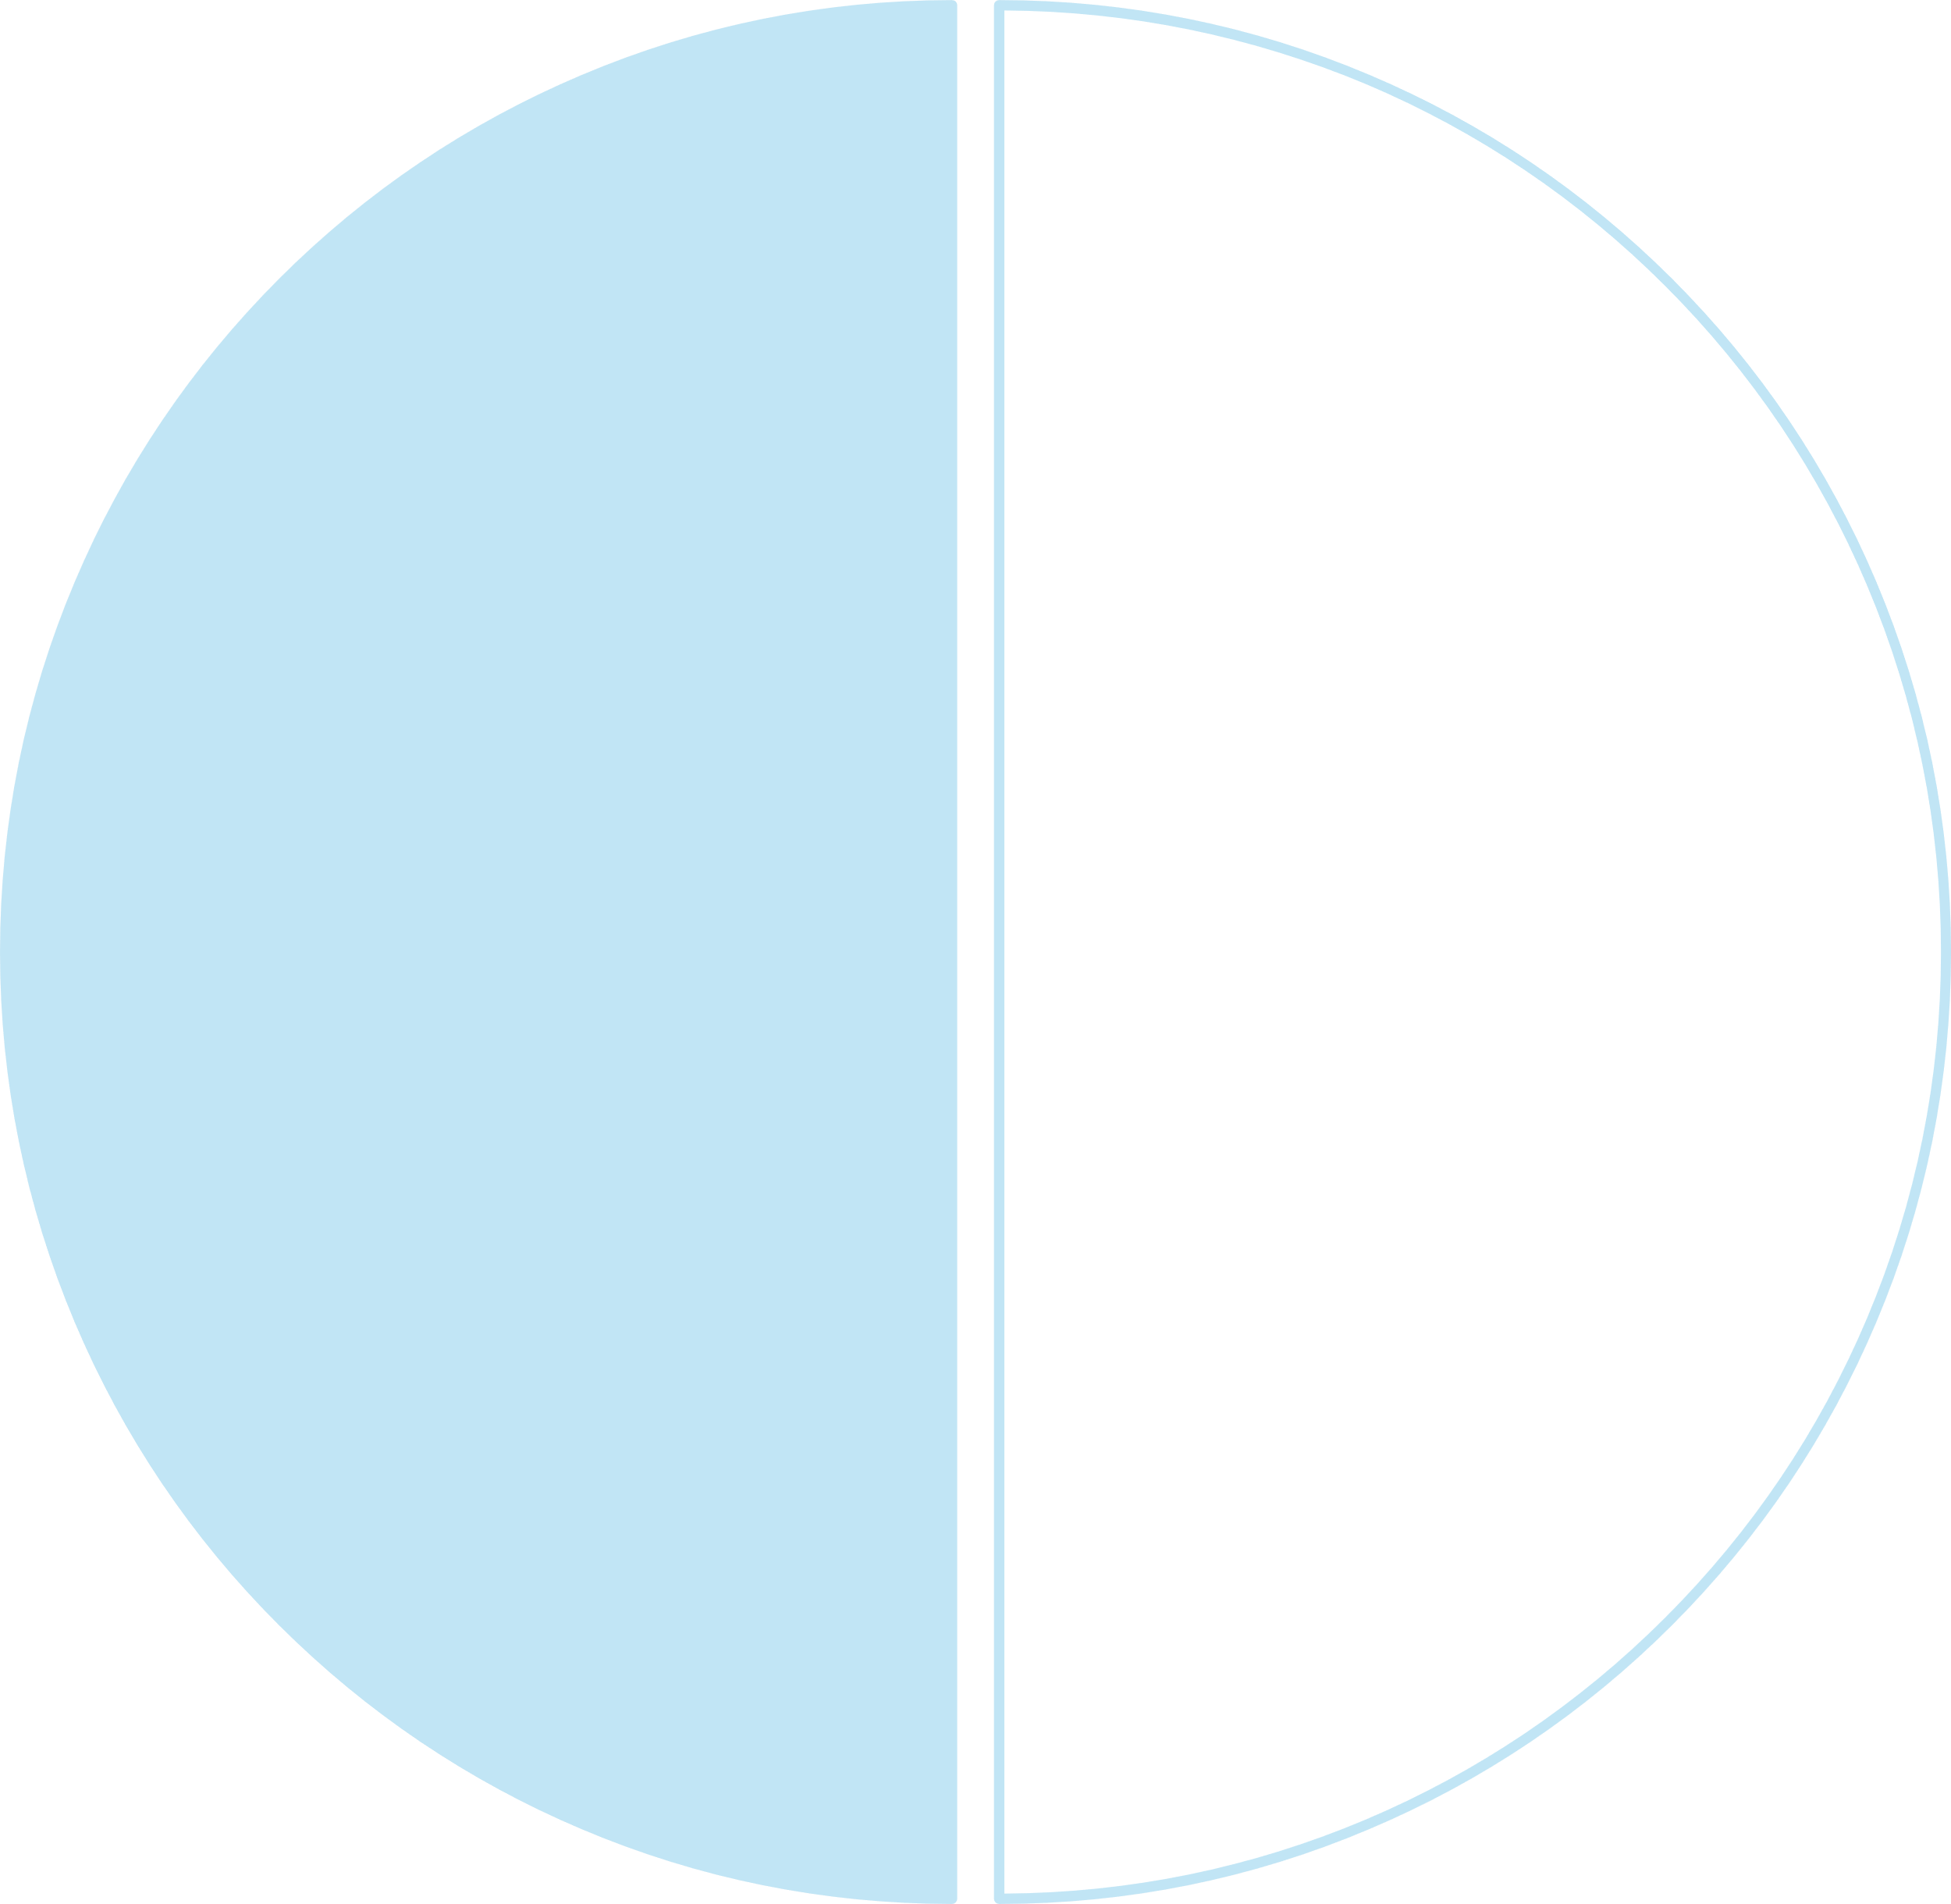
People-First Language:
Mental Health and Substance Use Health
Stigmatizing
Commit / committed suicide
They’re suicidal
The mentally ill
They’re schizophrenic
Addicts, druggies, crackheads
Drunks, alcoholics, people with alcoholism
Respectful
Died / death by suicide, lost their life to suicide
They’re facing suicide / thinking of suicide / experiencing suicidal thoughts
People with mental illnes
They have schizophrenia / are living with schizophrenia
People with substance use disorder
People struggling with their substance use
People with alcohol use disorder
Notes:
Language is a powerful tool, and it is one of the ways we can work to reduce stigma related to mental illness and substance use. The words we use can either reinforce negative stereotypes, or feed into them. Using person-first language in our day-to-day conversations can help to reduce common myths and misconceptions.
With person first language, we talk about and emphasize the person before we mention their diagnosis. For example, instead of saying the "mentally ill" we would say people with mental illness.
One of the most common phrases we hear : "They committed suicide'. This implies a criminal element to someone's death, like they committed a crime., and further stigmatizes a person and their loved ones. It comes from a time when attempted suicide was illegal.
(Then review others)

Slide 37
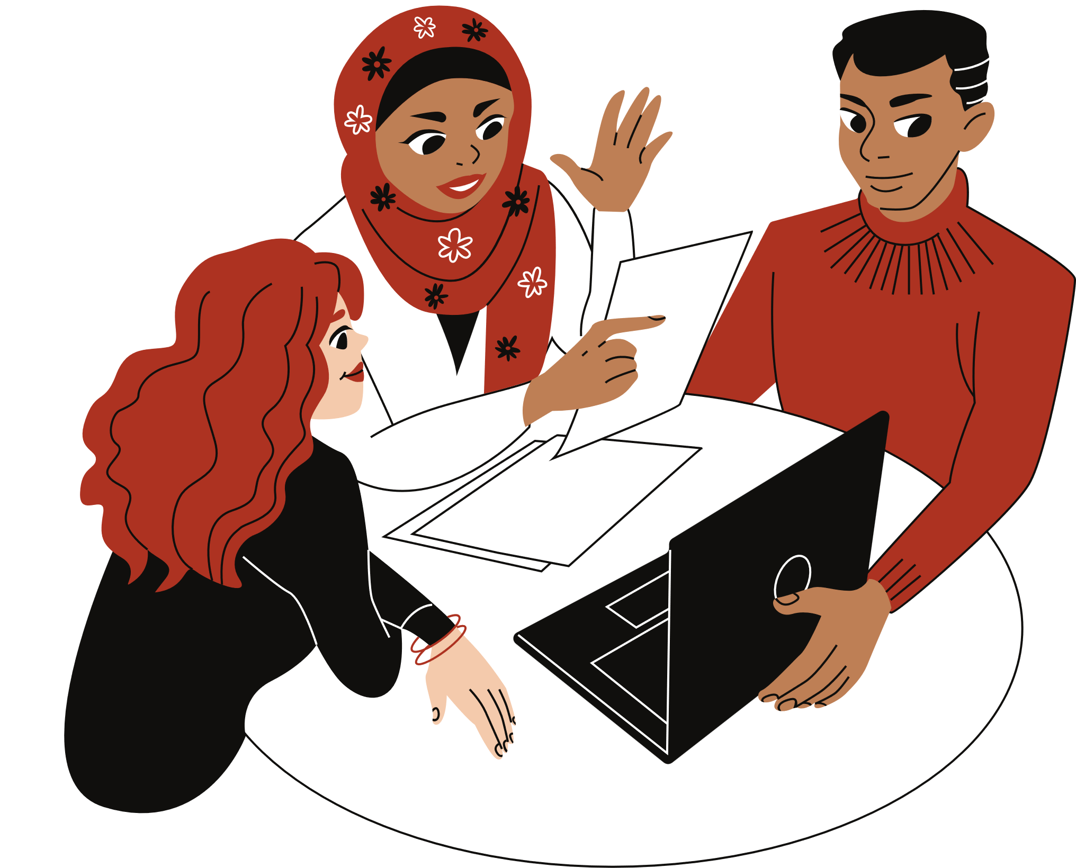

Activity!
Notes:
Activity option1: Think about words you have heard that are stigmatizing. How can you as students help to shift the culture, so these words are use more carefully?
Activity option 2:
Activity Suggestion: People-First Language
Supplies required:
Two title cards - "Stigmatizing" and "Respectful"
Laminated cards with examples of respectful and stigmatizing language
Masking tape or painters tape
Directions
Ensure you have several cards available. Each card includes various examples of stigmatizing and respectful language – not just the examples that are listed on this slide.
Shuffle the cards – have larger print, if possible, so that phrases can be read from a far distance (there are approximately 2-3 phrases per page).
Divide the youth into two or more groups and have them line up one behind the other (in a relay style). Divide the cards equally between groups.
Ask youth to work together in their groups to discuss the cards. When the group is ready to answer, the first person in the line will stick the phrase on the wall under the correct headings (either stigmatizing or respectful).
After answering the youth will then re-join the back of the line. Repeat steps 1-5 until one group has no cards remaining.
Review the examples of respectful language and reference stigmatizing language as needed.
37

Slide 38

What is Stress?
grades
expectations
  A part of everyday life
  A response in the body to a demand or challenge
  Can be real or imagined
  Is highly subjective
who am I?!
Notes:
Video: https://www.youtube.com/watch?v=LlPOk-kG6r0
“Everyone experiences stress to some degree. Animals feel stress. Fish feel stress. No joke, EVERY LIVING THING feels stress. It's part of everyday life. It’s a natural response to anything that threatens us, challenges us, worries us and/or causes us great emotion like a getting new job or an upcoming deadline for a school project.”
Play the video: 2:40 min
https://www.youtube.com/watch?v=LlPOk-kG6r0
Discuss some main takeaways about the video:
Stress is not always caused by negative events
Stress is not necessarily a bad thing – an optimal level gives us motivation to get stuff done
Our thoughts can play a large role on how we experience stress
38

Slide 39
What is Stress?
grades
expectations
  Some stress is necessary to keep us alert, energized and help us perform better
  Too much stress and not coping with those stressors in our life can interfere with our ability to do normal tasks
  Overall stress impacts our mental health and well-being!
who am I?!
Notes:
Video: https://www.youtube.com/watch?v=LlPOk-kG6r0
“Everyone experiences stress to some degree. Animals feel stress. Fish feel stress. No joke, EVERY LIVING THING feels stress. It's part of everyday life. It’s a natural response to anything that threatens us, challenges us, worries us and/or causes us great emotion like a getting new job or an upcoming deadline for a school project.”
Play the video: 2:40 min
https://www.youtube.com/watch?v=LlPOk-kG6r0
Discuss some main takeaways about the video:
Stress is not always caused by negative events
Stress is not necessarily a bad thing – an optimal level gives us motivation to get stuff done
Our thoughts can play a large role on how we experience stress
38

Slide 40

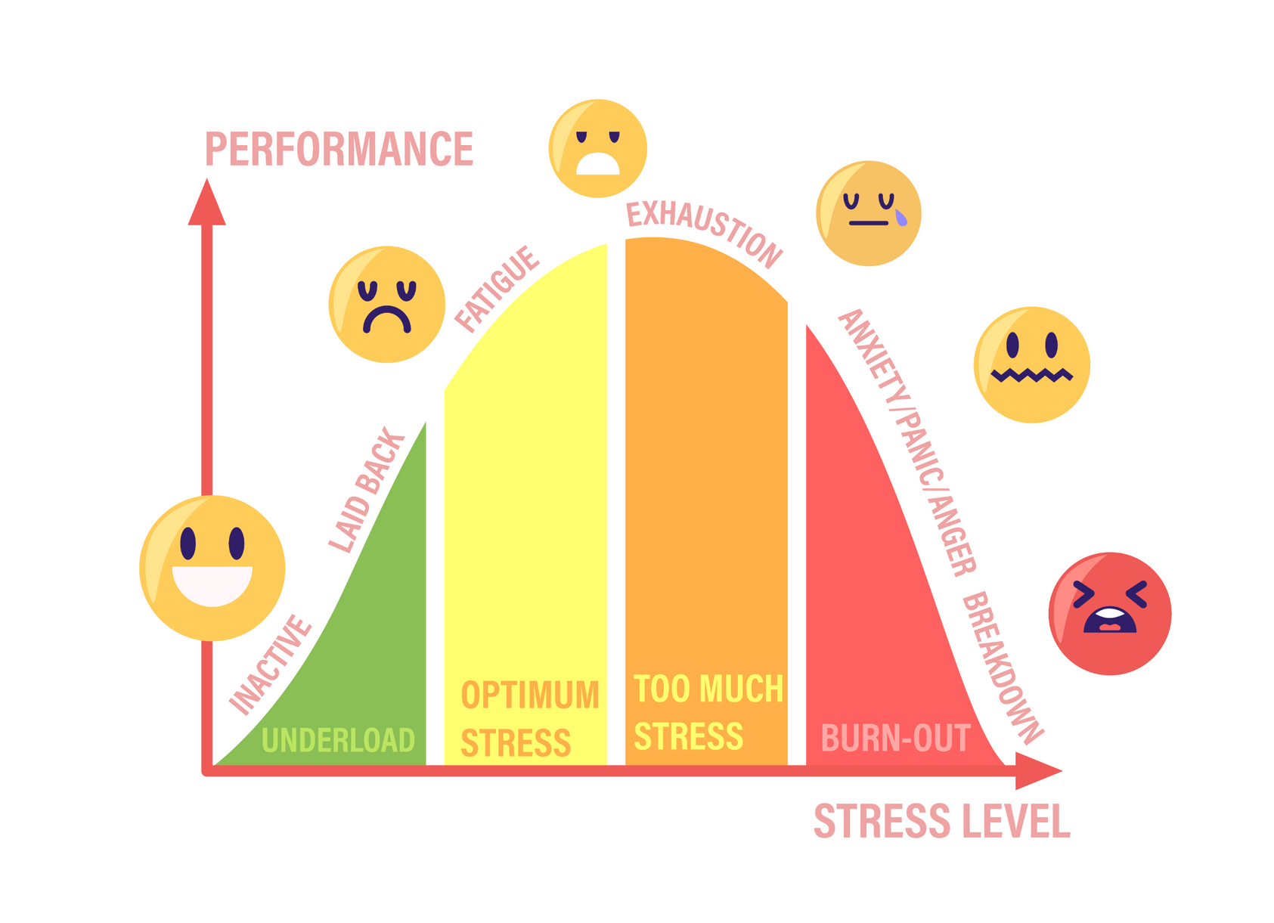
Stress performance curve
Source: Adobe Stock
Notes:
Angela
Time: 3 mins
“Our society spends countless dollars on wellness products to avoid or reduce stress, and we're encouraged to chase the belief that happiness means having no negative emotions. This way of thinking is not healthy for us, mentally or physically. Our lives are not about avoiding stress, but rather about embracing uncertainty, daily challenges and, at the same time, learning to adapt and be resilient.”
“Stress is not always a bad thing! Some stress can make you alert, motivated, productive and perform better. Too much stress on the other hand, and not being able to properly manage it, can harm your ability to do normal tasks and, in the long run, damage your mental well-being. You may choose unhealthy coping strategies like substance use, change eating habits, avoid people or other to deal with stress.”
“Let's not forget that sometimes negative emotions are part of good mental health. Crying, feeling sad, irritated, or angry are normal responses to life's challenges. Just because we feel stressed or a “negative” emotion doesn't mean we don't have good mental health. In fact, when we can identify stress and know how to overcome it is a fundamental element of good mental health.”
39

Slide 41
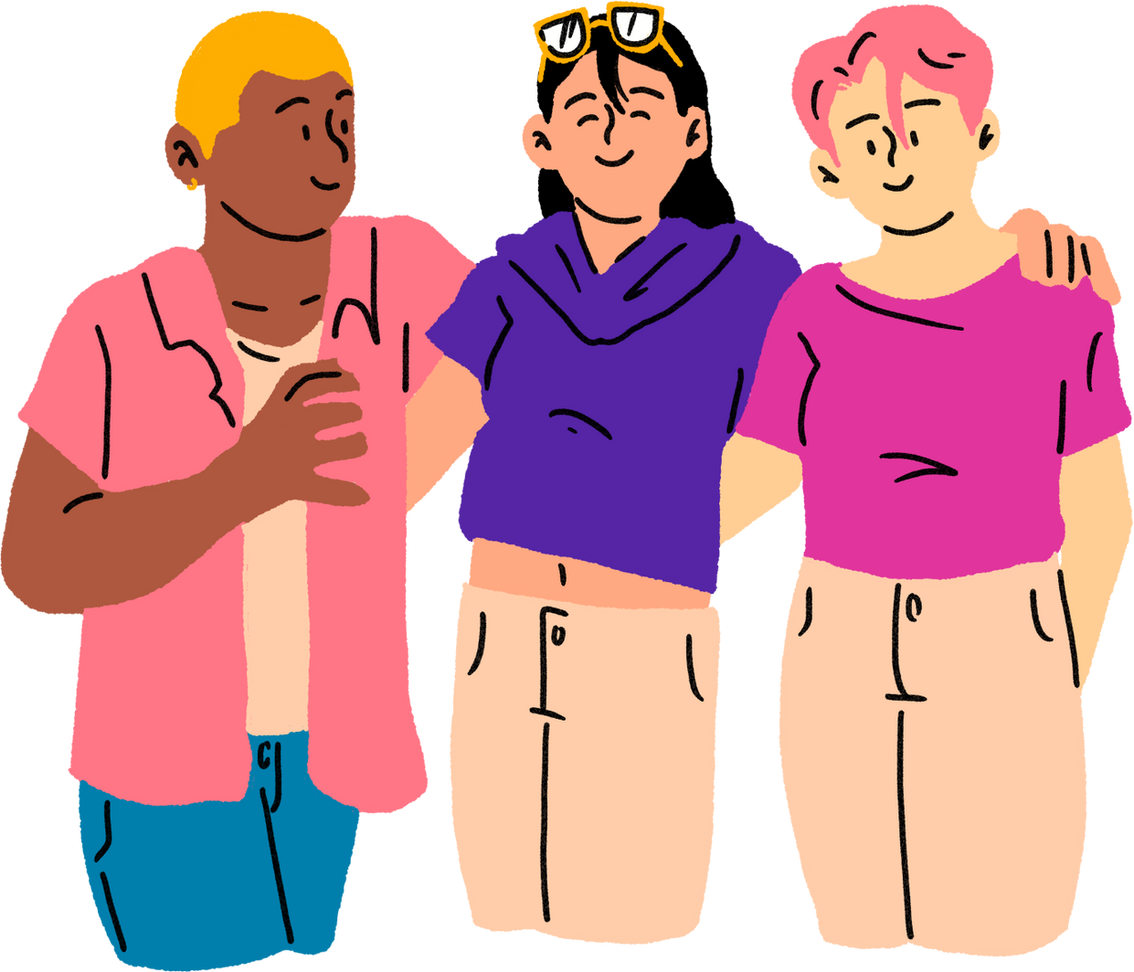
Human Continuum Activity
Notes:
Human Continuum Activity
Directions:
Have participants line up in a straight line (shoulder to shoulder)
Explain: you will read statements, if the statements apply to participant, they will take a step forward, if it doesn’t apply they step backwards.
\Have participants look around at the end and see where others are standing in relation to them.
Possible Statements:
When I am feeling stressed, I get frustrated, angry or irritable.
When something bad happens, I get angry quickly.
I get upset/sad if I miss events because of school and/or work.
When I am feeling stressed, I use technology and social media to avoid what is bothering me.
When I am feeling stressed I get worried and anxious and I cannot stop thinking about what is bothering me.
When I am under stress, feeling worried or sad, I want to be alone and stay away from my friends and family.
I have felt bad after getting mad at someone and wished I had reacted differently?
I take time to relax.
I do something just for me each week.
Debrief:
What are some situations that could cause emotions like sadness, worry and/or anger?
Exams or tests;
Fighting with friends/parent
Loss of a loved one (family member, pet);
Bullying/cyberbullying
Parent’s divorce; and
Illness.
Depression, anxiety or other mental health challenges
Worry about a friend’s, family member’s or your own substance use
Body image
Navigating sexual orientation and gender identity
Experiencing racism, sexism, transphobia or other forms of discrimination
Climate change and other world events
Can feeling sadness, anger or worry influence how we react to a situation?
What are some symptoms related to stressful or upsetting situations? How do we feel inside when we are upset?
Can stress be good for us? What are some examples of good stress?
Some stress in our lives can be necessary to help keep us alert and energized, and to help us get things done. We can understand this type of stress as “good stress”. Good stress is short-term, manageable, and often useful

Slide 42
Group Activity
Good Bad
STRESS
and
Notes:
Activity: Good and Bad Stress
Time: 15 mins
Good and Bad Stress
Label three sheets of flip chart paper with the following titles:
(Divide this sheet down the middle) Positive Coping | Negative Coping
(Divide this sheet down the middle) Positive Stressors | Negative Stressors
People or Places to Go for Help at TDSS?
Facilitation Instructions:
Discuss with students:
Can you think of a time where it was helpful to feel nervous or stressed?
Think about a time you’ve felt stress. How did you deal with it? If you could go back in time, would you change how you reacted with that stress? How would you like to deal with stress in the future?
Let students divide themselves into 3 groups.
Assign each of the groups to one sheet of paper.
Explain the activity:
Each group has 60 seconds to draw/write all of the ideas they can come up with at the first sheet of paper they are at.
At the end of 60 seconds, have the groups rotate to the next sheet of paper and provide 90 seconds to do the same – advising them not to repeat ideas of the group before them.
Repeat above step, but provide 120 seconds.
Once all the groups have moved through the three stations, review/discuss/categorize all of the ideas presented on the sheets as a large group.
Leave sheets posted for reference in the next portion of the workshop.
41

Slide 43
How do you cope with stress?
Notes:
Activity:
Explain that everyone experiences emotions like anger, worry and sadness at points in their life. For many of us it may not just be one of these emotions, but a combination. Sometimes when we are under normal stress and we find that the anger, worry, or sadness in our life is getting to be too much we may need to check in with the supports in our life. If our family, friends, work, school, or leisure time gets severely impacted for longer periods during these struggles, professional mental health support can often help.
Next, ask youth to think about how they cope with stress:
Do a stress check-in – what is going on in my life?
Recognize signs – what am I feeling?
Learn what triggers are – what is making me feel this way?
Have a plan to help manage everyday stressful situations and manage those feelings
Add to your resilience
What coping strategies can you use to add to your resilience?
Thinking positively
Talking to a trusted adult
Practicing deep breathing and relaxation exercises
Getting out in nature and being active
Getting enough sleep
It is important to realize that we all react to stressful situations in different ways. We may even react to stress differently ourselves, depending on the situation. However, once we become aware of the signs of stress we are better able to recognize them in ourselves and apply our coping strategies.
Video Mindfullness Exercise: https://www.youtube.com/watch?v=s0PO2xo7I9g”

Slide 44
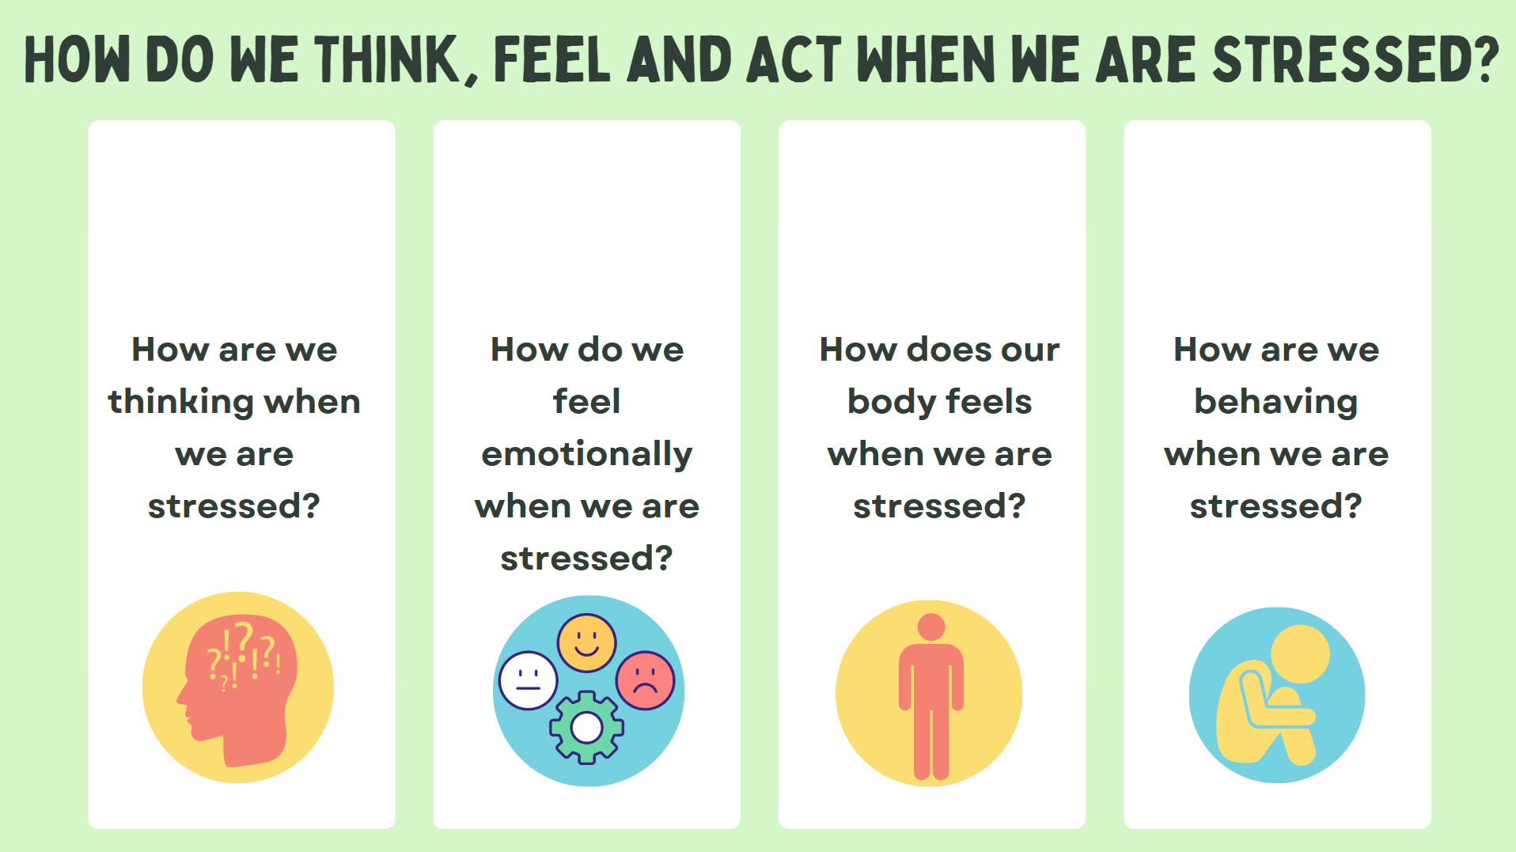
Notes:
Activity: Students in groups discuss questions
43

Slide 45
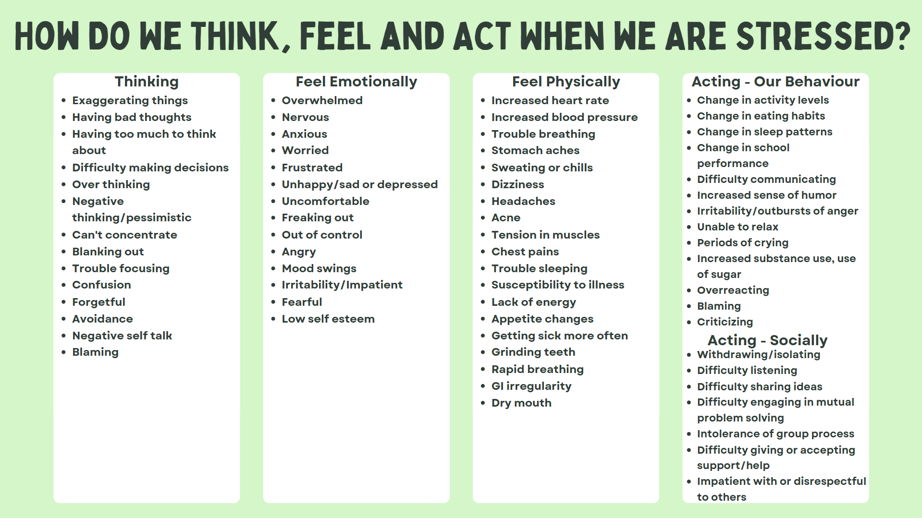
Notes:
Answer to above activity
44

Slide 46
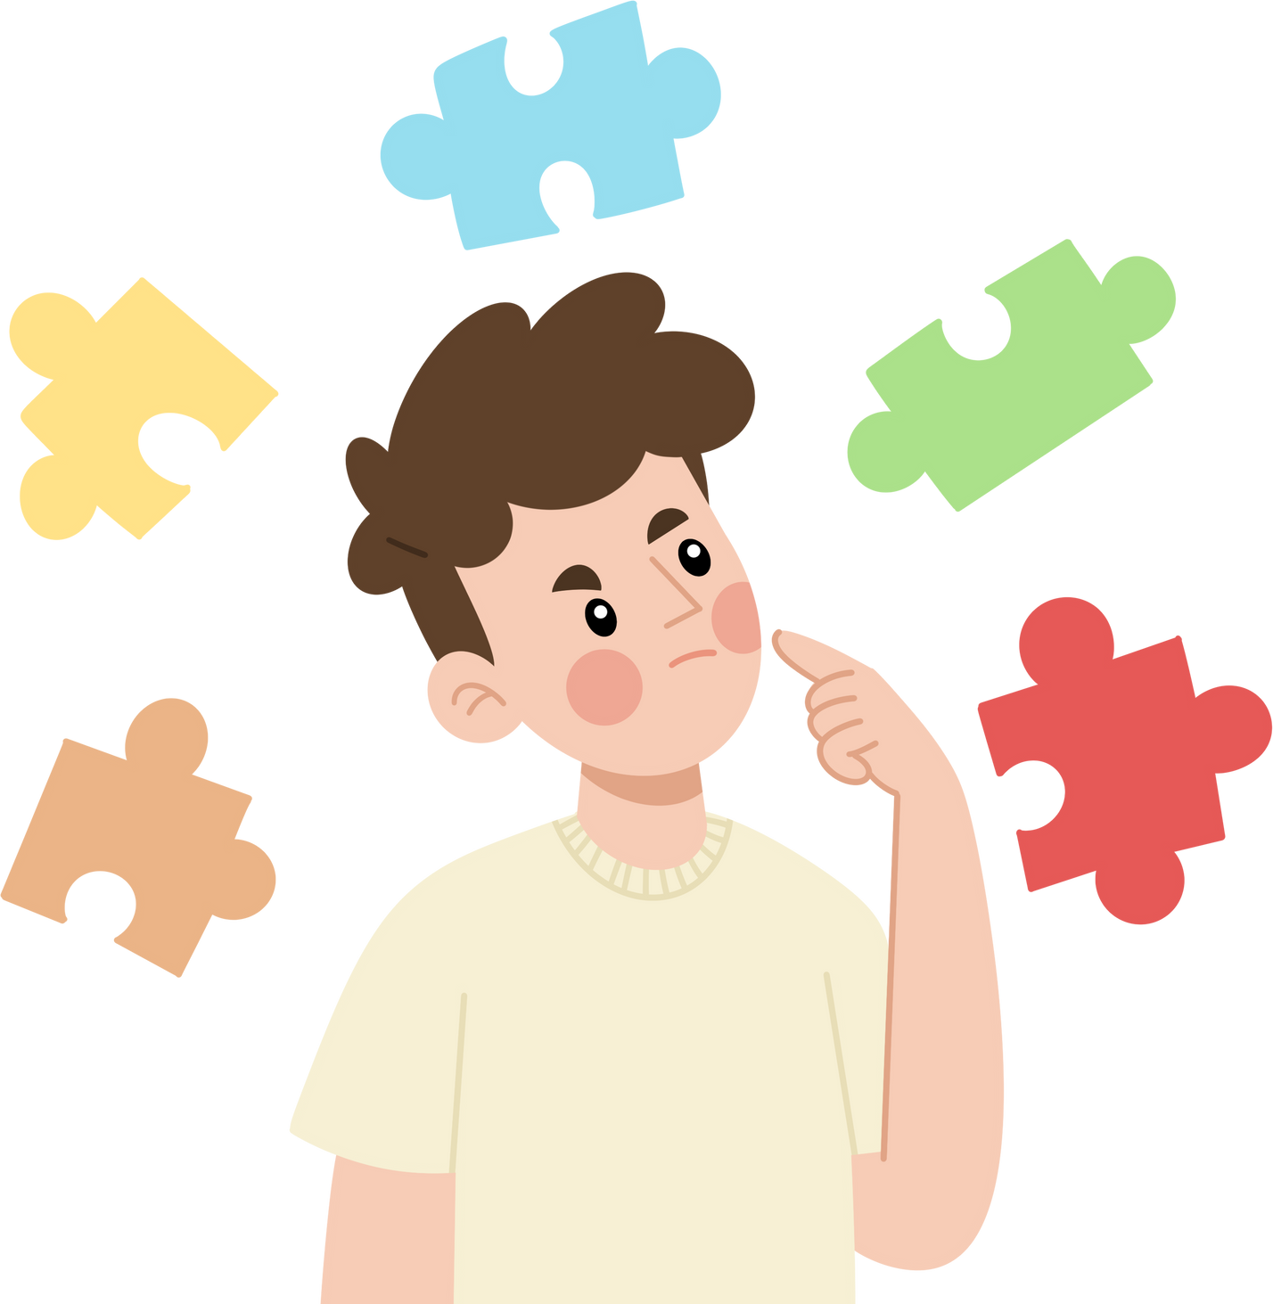
Healthy Coping Strategies for Stress
Many people deal with stress using coping mechanisms.
What are some healthy coping mechanisms you use? (Think, Pair, Share)
Notes:
May also want to ask youth: What are some unhealthy coping mechanisms that you or others you know use?
45

Slide 47
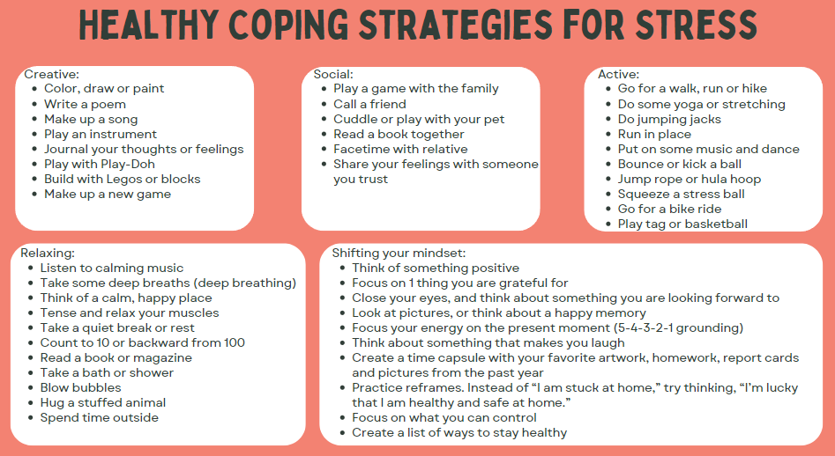
Healthy Coping Strategies for Stress
Many people deal with stress using coping mechanisms.
What are some healthy coping mechanisms you use? (Think, Pair, Share)
Notes:
May also want to ask youth: What are some unhealthy coping mechanisms that you or others you know use?
45

Slide 48
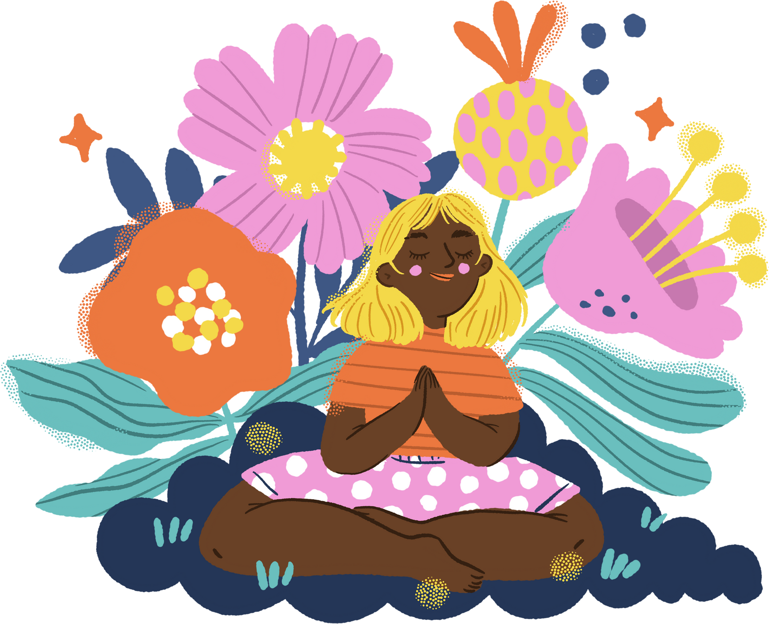
Deep Breathing &
Mindfulness
Notes:
Activity Option 1:
Mindfulness is the act of being present in the moment. There are many different ways to practice this skill. One way is through practicing deep breathing.
We are going to give that a try today. Deep breathing helps to calm our bodies when we are stressed and it is a skill that needs to be practiced like any other skill. Just like in any sport you need to go to practice and participate in the drills in order to play your best in the playoff game. We need to practice deep breathing or any mindfulness activity when calm to teach our bodies so it can be effective when we are feeling stressed.
Before beginning ask participants how much stress they are feeling on a scale of one to ten. They can use their fingers to show their stress level. Explain to the group they are going to try an exercise which may improve feelings of stress.
Make the room as comfortable as possible (e.g. turn down the lights or play relaxing music.)
Read the following “Take Time to Breathe” script:
Sit comfortably, with your knees bent and your shoulders, head and neck relaxed.
Place one hand on your upper chest and the other just below your rib cage. This will allow you to feel your diaphragm move as you breathe.
Inhale through your nose. The hand below your rib cage should move out. The hand on your chest should stay as still as possible.
Tighten your stomach muscles, letting them fall inward as you exhale through your mouth. The hand on your upper chest should stay as still as possible.
Have participants practice deep breathing for about 15-30 seconds. Explain that deep breathing can be used any time they need a short break. This is a good way to take a “time out” from a situation and relax.
Ask participants on a scale of one to ten how stressed are they feeling after completing the exercise and how the activity made them feel.
Possible Participants Answers:
Feelings afterwards: relaxed, calm, quiet, less stressed, some participants may not feel any different; some may feel more stressed because they could not stop their thoughts from wandering. This is normal and improves with practice.
Some participants might find these activities difficult. Remind participants that it takes time and practice to learn new skills.
Alternative:
Video Mindfullness Exercise: https://www.youtube.com/watch?v=s0PO2xo7I9g”
.

Slide 49


Stress-Busting Mural
Notes:
Activity Option 2:
In this activity, you will have the youth identify stressors followed by brainstorming healthy ways to cope. The focus for this activity is not on the stressors but rather the coping strategies, the problem solving, and the strength of the group.
Part One:
Ask youth to name different stressors in their lives (e.g., homework, tests, jobs, parents, relationships, friendships, conflict, mental or physical health challenges). Capture these examples on flip chart paper.
Part Two:
Ask youth to think of a time when they have experienced a stressful time or faced challenges. What helped them through it? Capture these examples on flip chart paper.
Part Three
Ask youth, as a group, to create a stressbusters mural with various positive coping strategies either written or represented through art on flip chart or mural paper.

Slide 50
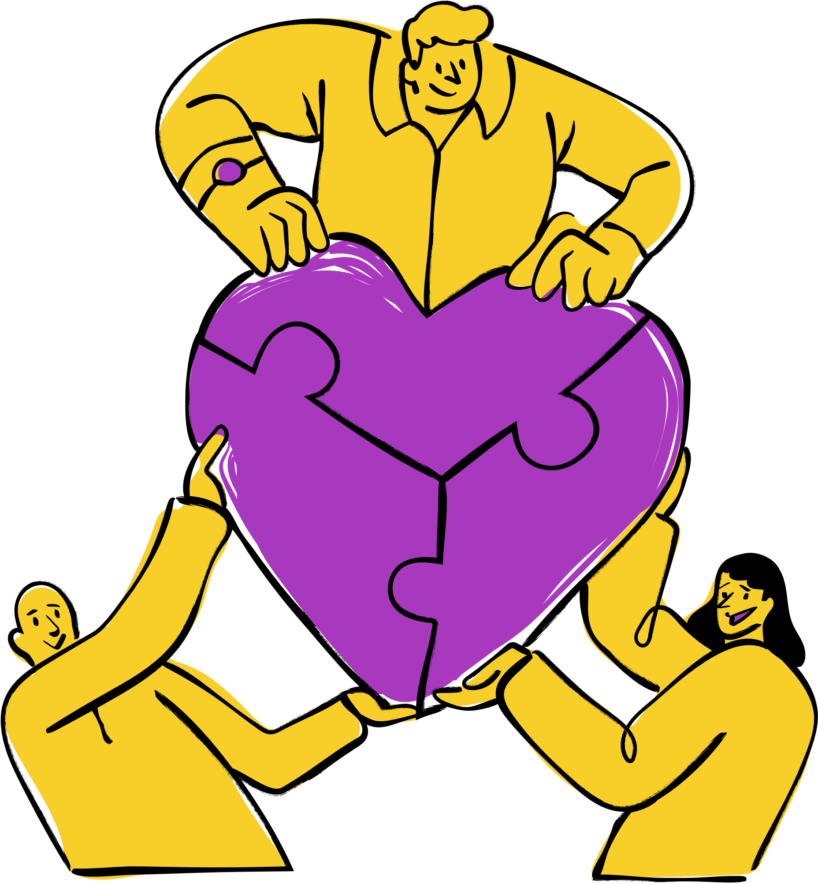
Stronger Together Activity
Notes:
Activity Option 3:
“Stronger Together” creates an opportunity to recognize that while personal coping strategies are important, it is also important to ask for help. . You can use this icebreaker to discuss how people often benefit from more than one person to help them when they are experiencing challenges.
Directions:
Scrunch up a piece of paper to make a paper ball. Ask a youth to identify one possible support and come to the front of the class to hold the ball of paper with one finger (paper ball falls).
Continue asking youth, one at a time, to identify people or places that they can go to for help and then come to the front of the group and try to hold up the ball together using one finger each,
Continue to ask youth to identify a support and add their finger to support the ball until there are enough fingers to hold the ball of paper (usually 4 to 5 youth).
Ask the group:
What happened when only one person tried to hold the paper ball on their finger? What could this represent?
What happened when more people came to help hold up the paper ball? What could this symbolize
What do you think this activity demonstrates?
Possible answers:
When we are dealing with an issue or challenge, we may need to rely on more than one person to help support us.
It can be challenging or sometimes nearly impossible to deal with issues all on our own.
When we have more people to assist us, our challenges may become easier to manage.

Slide 51
Discussion:
Help- Seeking
  What is help-seeking?
  What would you do if your friend was struggling? Was in crisis?
  Who are trusted adults in your school/community?
  Remember, your job is to listen and help your friend get the help they need. You do not need to know the answers, and your role is not to fix everything.
Notes:
This activity will encourage the Peer Leaders to think about the importance of seeking help. The discussion focuses on what they would do if someone needs help, as well as who they can reach out to when they need help.
Ask youth:
To define help-seeking.
Summarize and include that help-seeking is the attempt to get external, outside or other help to deal with (in this case) a mental health or substance use health concern.
What would you do if your friend was Struggling? Was in crisis?
Listen and be there for them.
Encourage them to get help.
Link them to a trusted adult.
If they are in immediate danger call 9-1-1
Break codes of silence when needed.
Remember, your job is to listen and help your friend to get help. You do not need to know the answers and your role is not to fix everything.

Slide 52
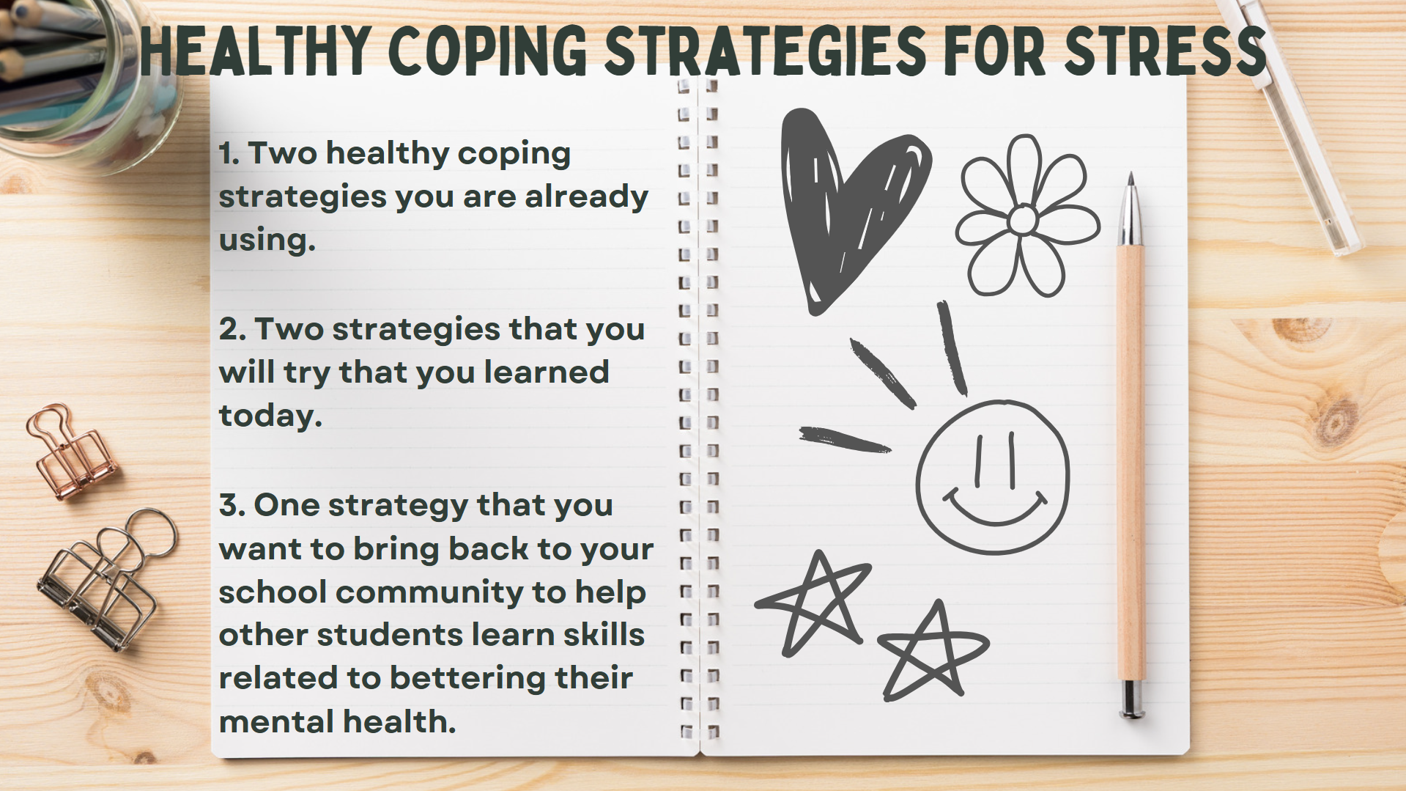

Slide 53
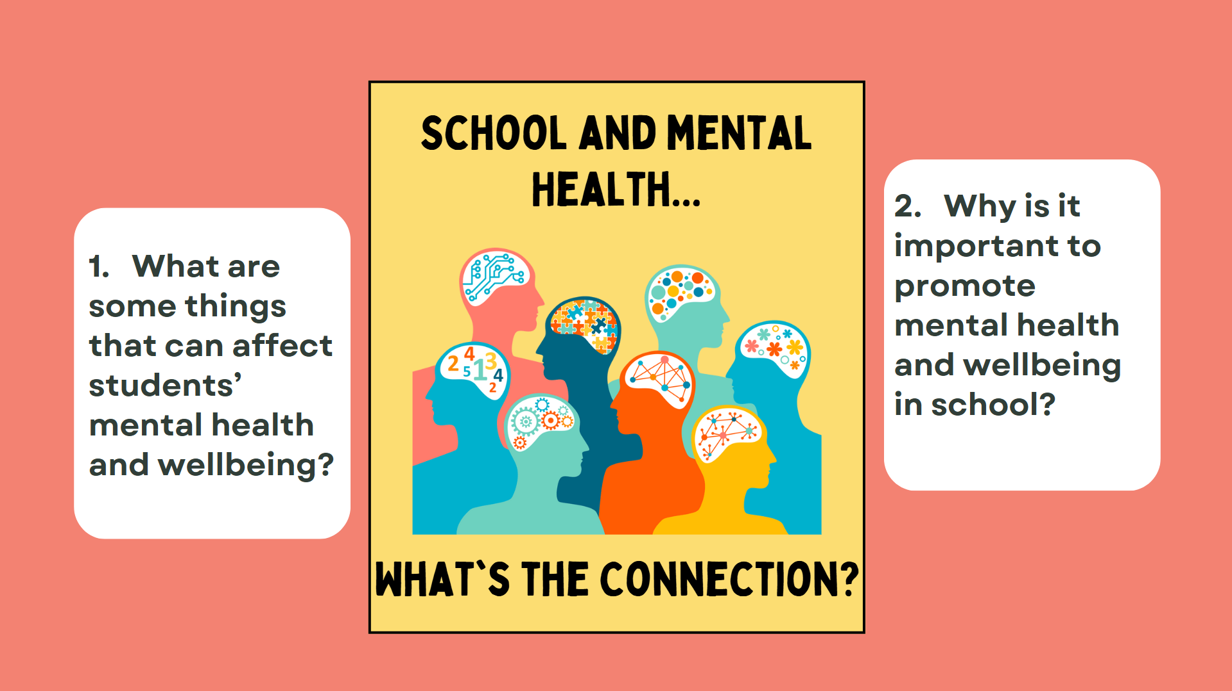
Notes:
Have students in group answer these questions
51

Slide 54
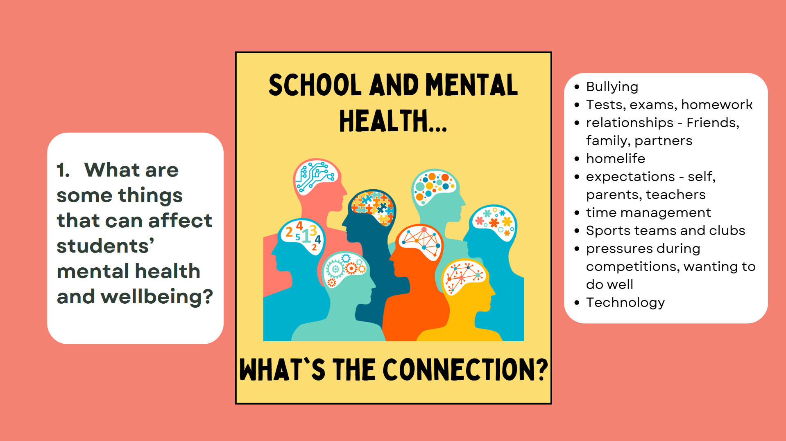


Slide 55
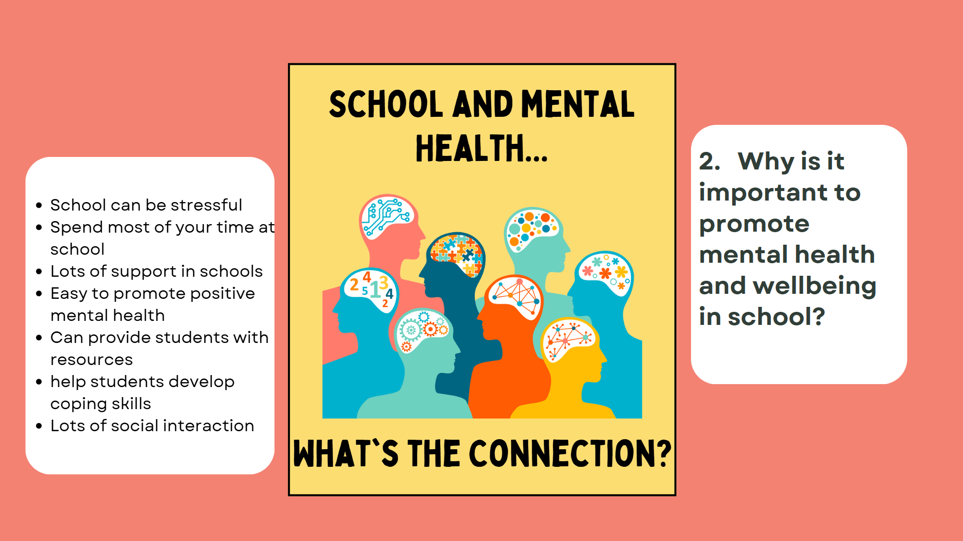


Slide 56
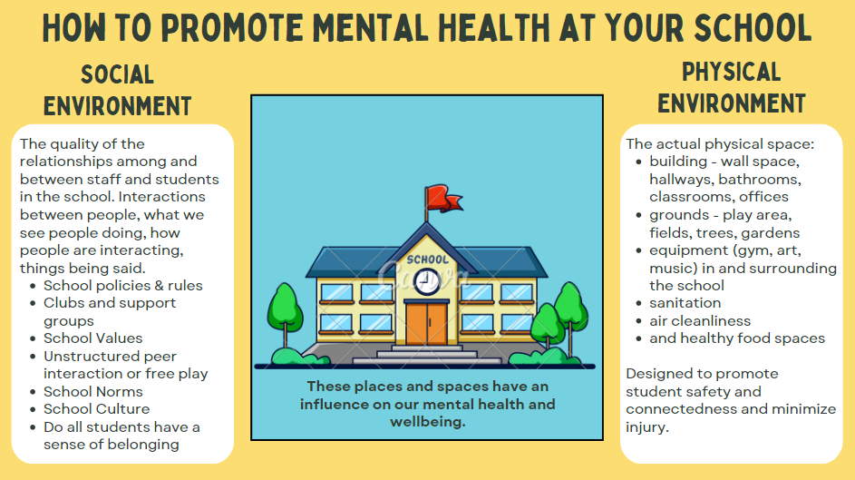

How can we support each other to use healthy coping mechanisms
and maintain our mental well being?

Slide 57
Discussion
Safe
Welcoming
Accepting
Respectful
Connected
Valued
Like they belong
Comfortable

Slide 58

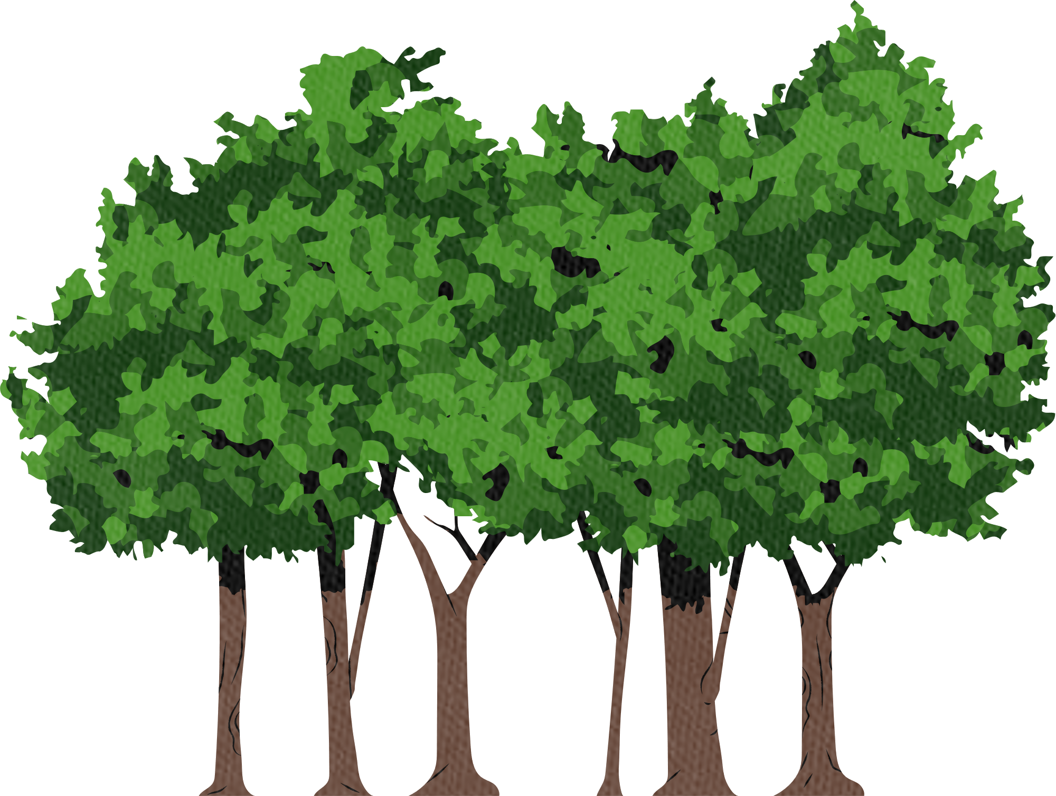
Once upon a time, there was a very strong woodcutter. They were the fastest, strongest woodcutter around. They were hired on the first day and fired on the fourth day.
But, WHY?!
The first day they cut down 40 trees. The second day they cut 25 trees. The third day 20 trees, and on the fourth, 10 trees.
When they were fired, the woodcutter asked, “Why? I worked hard and took no breaks.” The manager replied: “That may be, but you never took the time to sharpen your blade.”
Story time
Notes:
Remember as Youth Champions – self care is super important
Time: 5 mins
Ask a volunteer to read the Wisdom of the Woodcutter story.
“What did you get from this story?”
“As much as you want to help others, it's important to take care of your own health and well-being. If we pay no attention to ourselves, we might lose our ability to stay sharp.”
If time allows, you can share additional ways students can refuel their emotional or spiritual tank or ask what helps them stay sharp.
Accept challenges: Know and accept that life is full of challenges to overcome.
Create goals: Give meaning to your life by setting realistic goals and learning and trying new activities.
Build healthy relationships: Create healthy relationships with people you trust, who respect and support you.
Know and accept your strengths and weaknesses: Accepting your weaknesses in the interest of self-improvement is actually a vital strength.
Accept yourself and others: Be kind to yourself and others.
Understand the good and bad: Learn to recognize and understand that you and others have a variety of feelings.
55

Slide 59

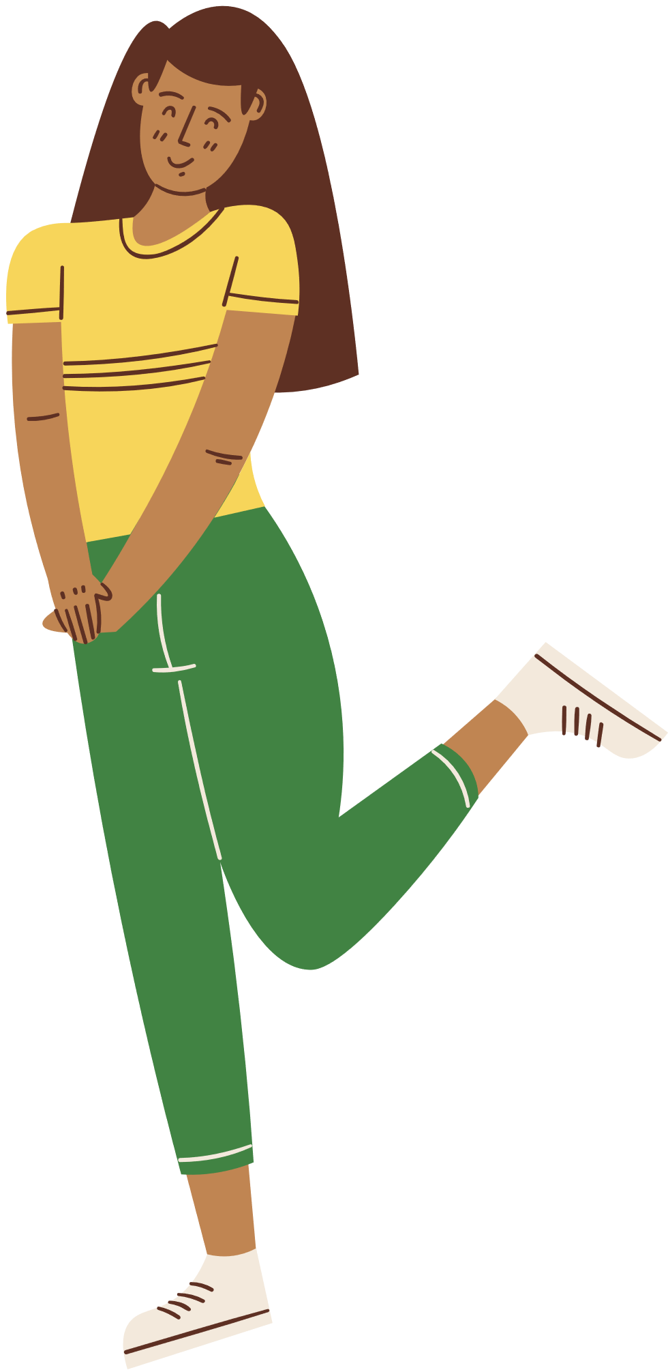
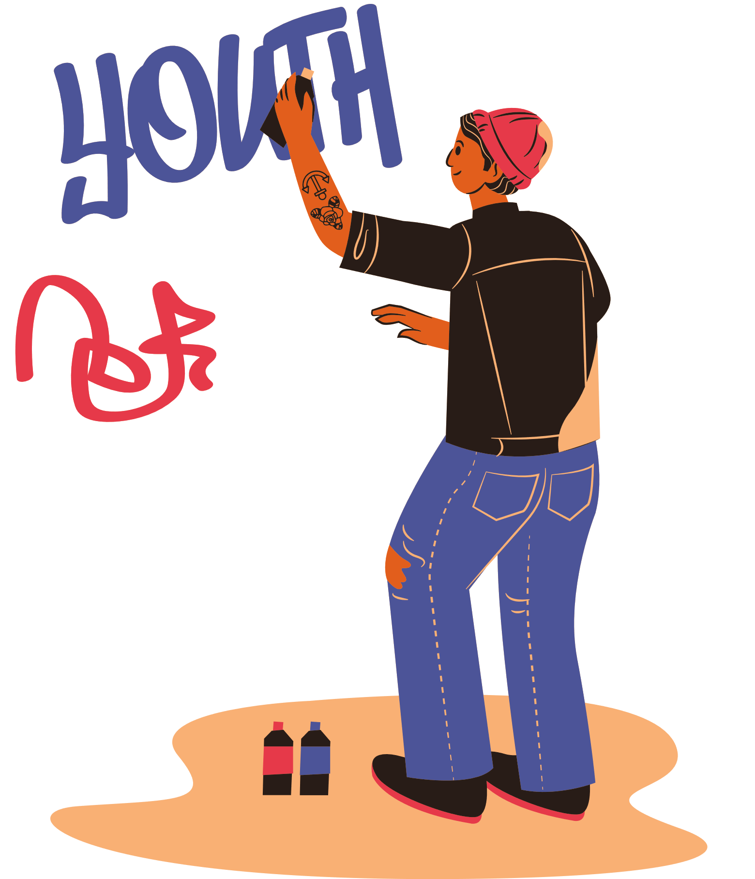
Agenda:
Youth Wellness Champions Planning

Slide 60
attend a workshop
be a team player, come to meetings and answer group messages
What’s your role?
work together to plan an inspiring activity
celebrate your success and
have fun!
Notes:
Reminder of Youth champion Role – plan and lead activities that share knowledge with your peers and promotes positive mental health and substance use health
“Our role as a group is to think about new ideas and ways to promote mental health & well-being in the school or community and make an action plan.”
Student expectations (all of you):
Attend a workshop – CONGRATS, you are doing it!
Attend group meetings. Your involvement is crucial! You know your peers best and what they need for their wellbeing. We’ll decide on meeting dates, times and frequency (weekly or biweekly) at the end of the workshop.
Work together to plan, implement and evaluate at least 1 activity in our school or community. The evaluation doesn’t need to be complicated. It’ll help us see if we reached our desired goal and how we can make it better next time around.
You’ll have the option to take on specific roles (ex: photographer, public speaker, decorator, graphic designer, etc.)
Your adult allies will support you to develop ideas and events that you will find fun and that will be most helpful to your own communities.
School Staff Champion / Adult ally:
We will help you with action planning and implementing the activities/initiatives.
We will help take care of the logistics and get approval of action plans.
We will also send meeting reminders and support you between the meeting times.
“I do want to be clear that although we’ll be talking about different types of mental illnesses or symptoms of mental illness, it is NOT your responsibility to diagnose your peers or provide counseling. As Champions in schools, you may be asked by peers for help with their mental health problems, but again, this is not your role. What you can do is share resources and support your peers by helping them find someone to talk to. Your teachers, your guidance counsellors, your principals, and VPs are always there to help students when they need more support. And our school has professionals like CYW (name) and mental health workers (name) to provide support to students when they are in crisis.”
Your role as a Youth Champion is to find ways to promote mentla health and wellbeing in your school environment!
57

Slide 61
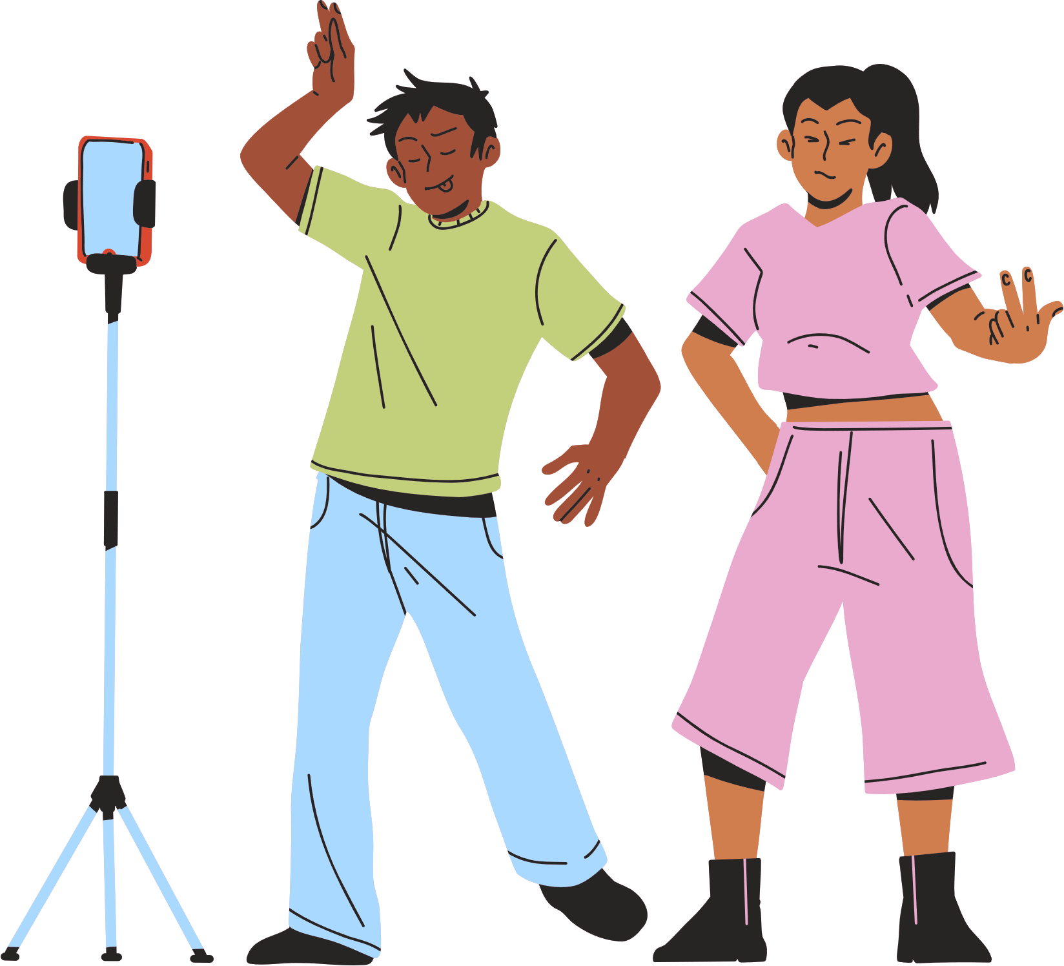
include
promote
understand
welcome
partner
Notes:
Remember as a youth champion – it is your role to help youth in your school:
Feel welcome
Feel included
Understood
Promote mental health and wellbeing
Partner with youth, trusted adults in your school to create a safe school environment
Consider:
Welcome – what does the ‘welcome message’ look like in your school?
Include: Who could be involved in creating and delivering key messages and actions for mental health promotion?
Understand: what resources and opportunities are available for students to increase their knowledge and awareness of mental health promotion?
Promote: What opportunities are available in the school setting to communicate about mental wellbeing
Partner – who are partners to help promote mental well being?
58

Slide 62

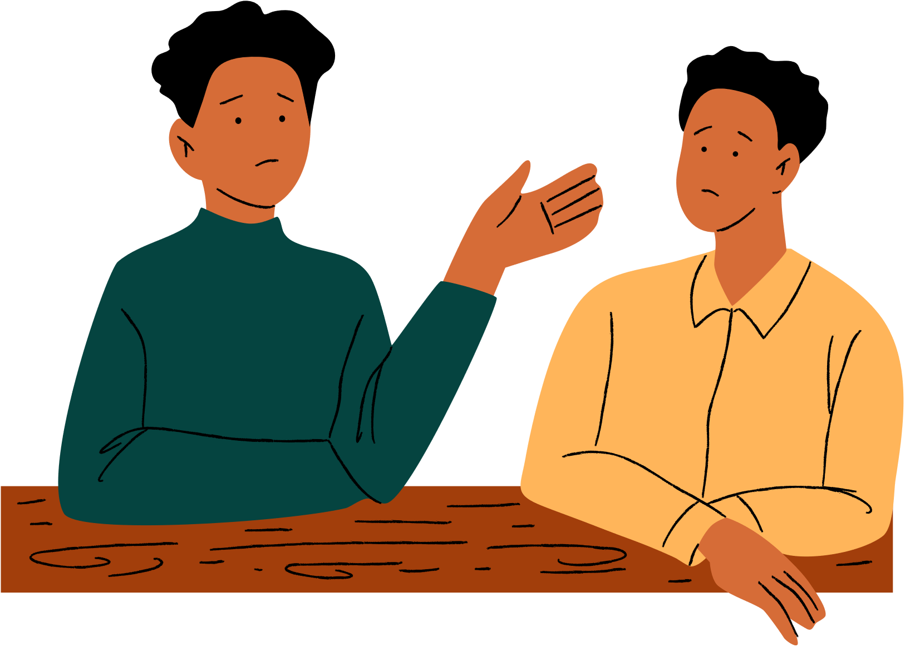
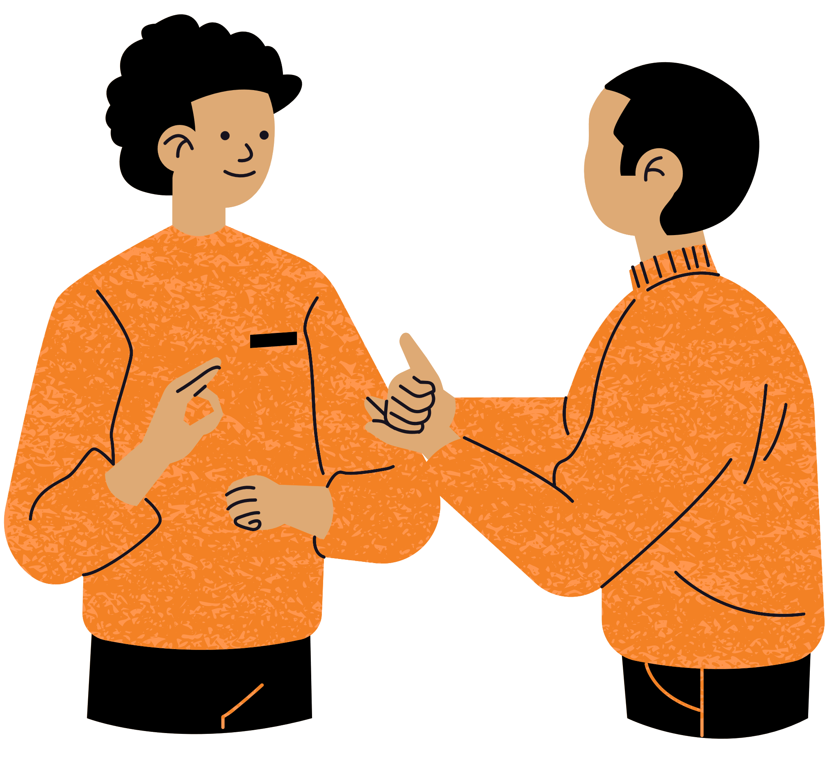
  You don’t need to know everything
  Find reliable sources together
  Consult an expert for more information
  When youth ask for advice:
    Direct them to trustworthy resources and services
    If unsure where to direct them, visit add local resource
Words of wisdom?
Answering the tough questions
Notes:
Reassure Adult Allies that:
- they are not expected to know everything about everything but instead are encouraged to work together with the youth to help guide them to someone who does, this can be by brainstorming reliable sources or consulting an expert.
We know that many youth want to talk to someone about mental health but don’t know where to turn. Youth may come to you with concerns regarding mental health, addiction, and substance use health. Take this opportunity to direct youth to trustworthy resources and services to ensure they are getting the support they need. If you are unsure about where to direct youth, visit Ottawa Public Health’s Mental Health, Addictions and Substance Use Health Services and Resources
Invite participants to share their own lessons learned or words of wisdom.
59

Slide 63
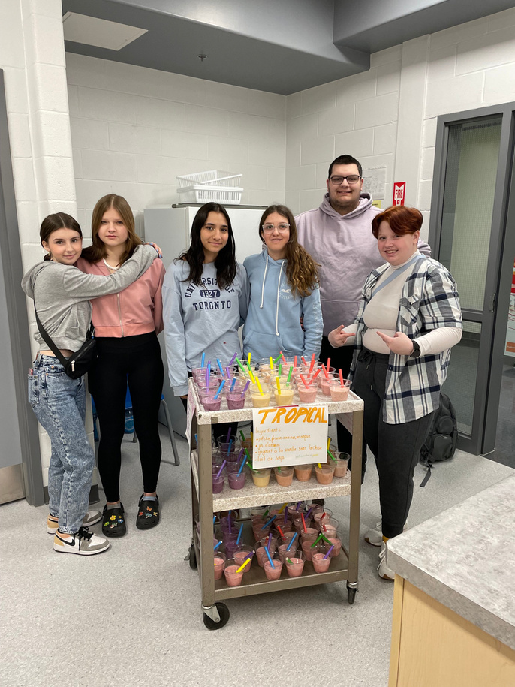

Action Plan
  Assess needs/gaps (Walk about)
  Set YWC goal
  Brainstorm ideas and choose activity
  Action plan for Activity
  Have fun holding Activity
  Evaluate Activity
  Celebrate and Share!
Planning Steps
Notes:
Stasia
60

Slide 64


Regular Meetings
  To continue the great work of YWC Program – we will be meeting regularly to plan and carry out our initiatives!
  When should we meet next?
  What’s the best way we can communicate?
Notes:
Time: 5 mins
Discuss meeting and communication plans to continue working on your action plan and goals!
What day of the week?
What time (during lunch or after school)?
Will there be snacks?
Can they accumulate volunteer hours?
What’s the best way to communicate during meetings? Text, email, Fb private page, social messaging app…?
61

Slide 65


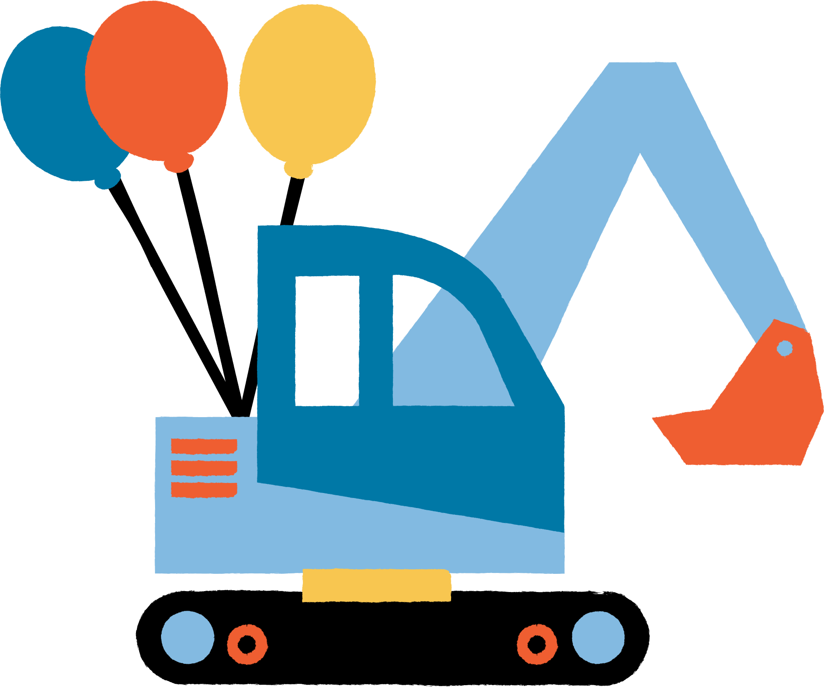

Let’s get to work!

Slide 66

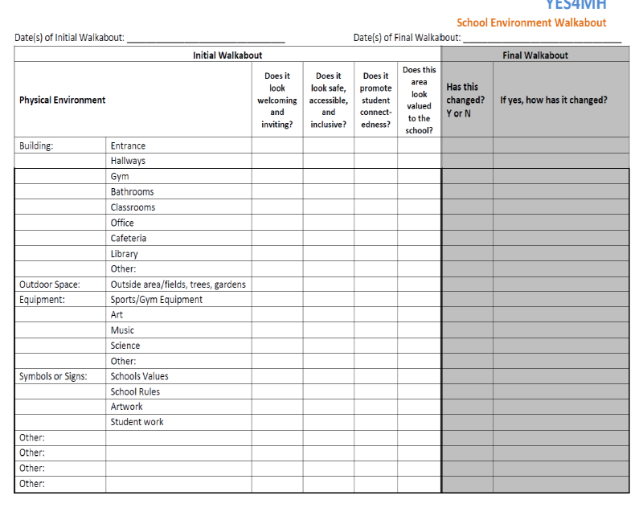
Step 1: Assess your physical environment -
The School walk about
Goal:
To identify areas that be supported in the physical and social environment to help make your school a positive environment that promotes mental health
Notes:
There are a variety of diff tools to use
The school walk about helps you look at the schools physical and social environment to identify gaps in the school and opportunities where change can be made to support mental health and wellbeing and make your school a more positive environment
63

Slide 67
  Assess your physical environment
    Do a school walkabout - look at the different areas of your school
    Survey students and staff
  Decide on a target audience
    Do you want to plan activities for the whole school?
    For older or younger grades?
  Decide on how you want to promote mental health and wellness in your school?
    Decide on what you want to focus on?
    What do you want to accomplish?
  Brainstorm activity ideas and choose the activity you want to do
  Action Planning
    What is the timeline?
    What resources will you need?
    Who will do what?
  Implement your events and initiatives!
  Celebrate all your hard work and evaluate!
Steps 2, 3 and 4: Planning for the Activity
Notes:
Now that you have done your physical and social assessment of your school throught the walk about – now consider:
Who is your target audience
What do you want to focus on – to promote mental health
What is your goal?
Specific: Who? What? Where?
Measurable: How much? How many? How often?
Attainable: How? Is it possible?
Relevant: Is it worthwhile?
Time-bound: When?
Brainstorm activities and ideas
Next few slides will show you a few samples that other schools have done across the province
NOTE: write answers on flipchart paper
64

Slide 68
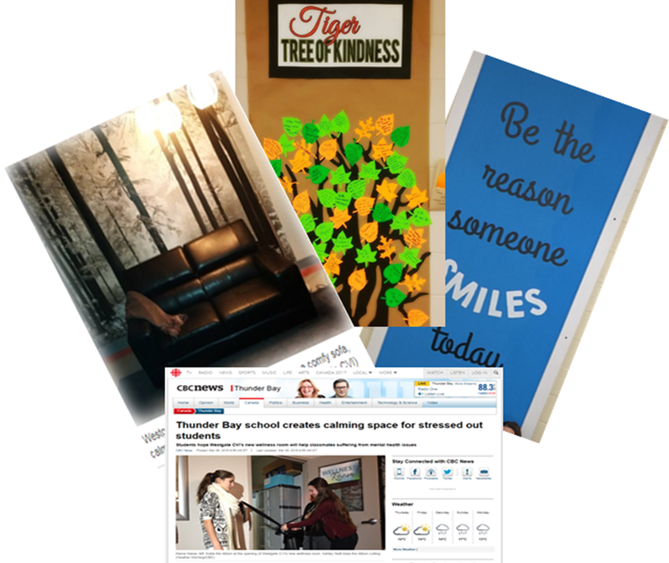
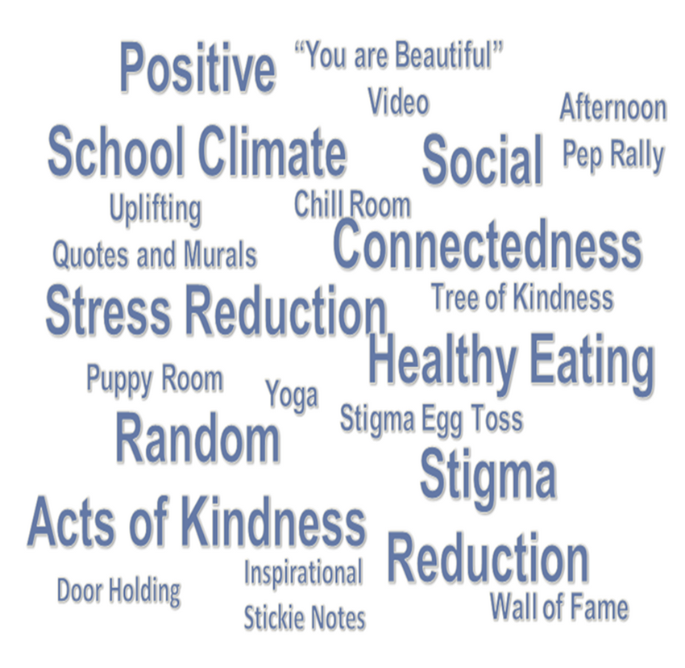
Activities
Notes:
Stasia
65

Slide 69
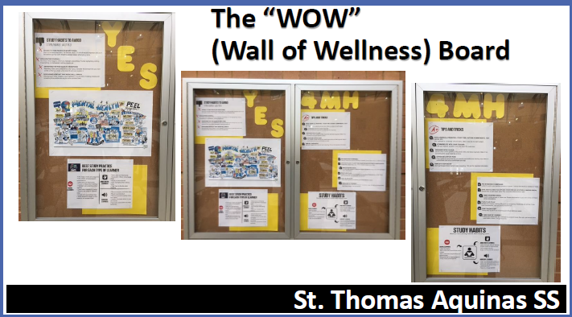
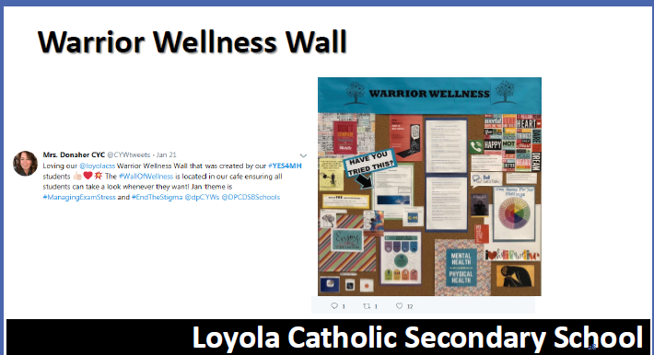
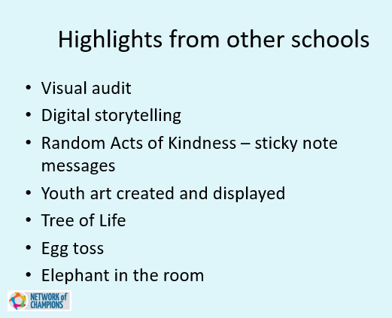
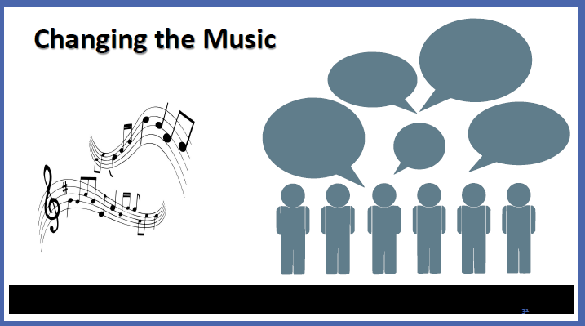
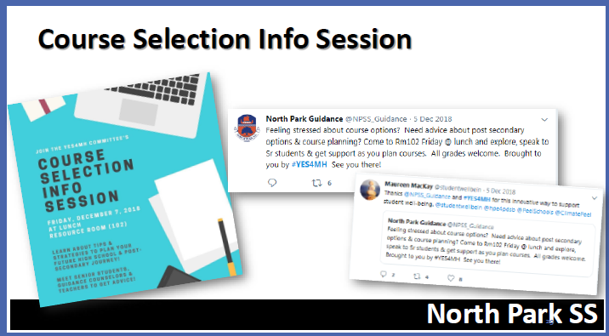
What’s been done before?
List what your school has done before.
Examples could include:
  Health fair
  Puppy days
  Caught you caring campaigns
  Using our pronouns
  Yoga
  Wellness Wednesdays (no tests on Wednesdays)
  Etc. etc.

Slide 70
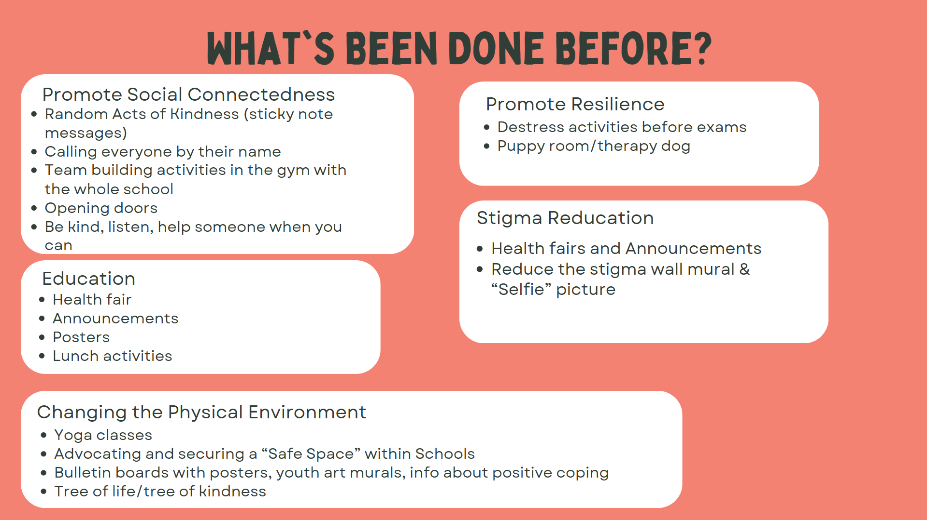

Slide 71

Step 5: Planning
Let’s brainstorm!
Notes:
Once you have identified the gaps and opportunities in the school it is time to plan initiatives
Activity Suggestion: Brainstorming
Directions
Divide youth into groups of 1 Adult Ally and 4-5 youth (depending on the number of participants).
Ask youth to brainstorm different activities and initiatives that they would like to do, or their peers may enjoy with support from Adult Allies.
After groups finish brainstorming, ask them to pick 1-2 of their favourite activities and fill out the planning form seen on this slide.
Come together as a large group to discuss potential initiatives.
Additional notes:
Start small, suggested topics include:
Mental health and substance use health resource and service awareness campaigns.
Stigma reduction campaigns.
Coping and stress management education and training.
Caring and sharing moments.
Acknowledging youth and their voice.
The following are sample campaigns that can be used as inspiration or adapted to the needs of a youth, community or school:
Candy grams or pencil grams: Attach messages or community resources to pencils during exams to give to students who have forgotten their pencils.
Caught you caring! Award youth who show kindness to others.
Chill room: Create a comfortable, non-judgmental space where students can “chill” when they need a place to relax.
Host a health fair.
Murals and graffiti walls: Create a mural or graffiti wall on a subject of your choice such as friends, community supports or gratitude.
Open doors: Peer leaders open the doors and greet students at the start of the day.
Post-it day: Use post-it notes to place affirming and positive messages on students’ lockers.
Worriless wednesday: Designate a Worriless Wednesday to promote coping strategies and community resources.
Yoga, meditation: Bring in an instructor to teach yoga, meditation or another relaxation technique or coping skill.
Web of positivity: Create a spider web of yarn with positive.

Slide 72

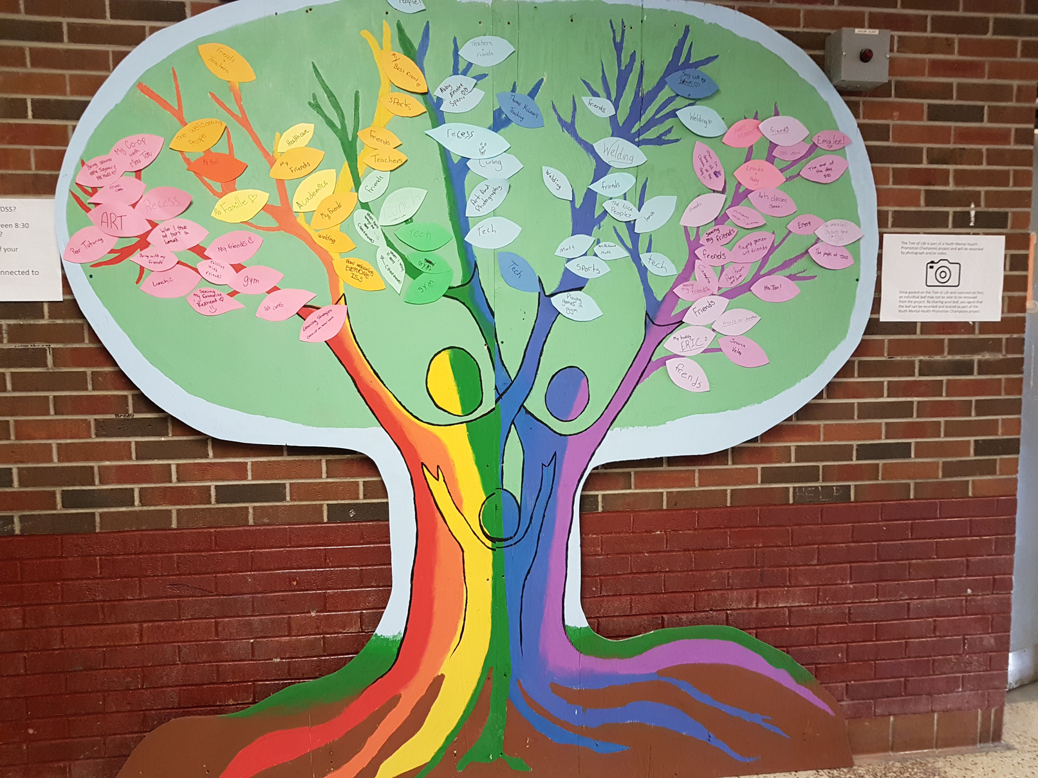

Step 6:
Implement the Initiative
Notes:
Now that you have planned your initiative – its time to roll it out!
70

Slide 73


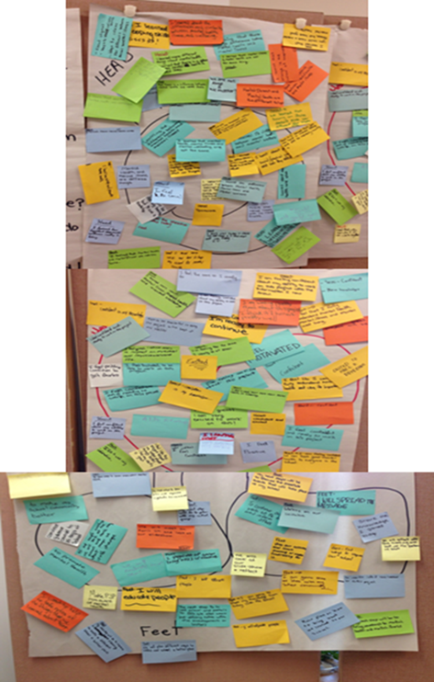




Step 7: Celebrate your Success!
Notes:
Remember to take time to celebrate your success and your hard work!
71

Slide 74
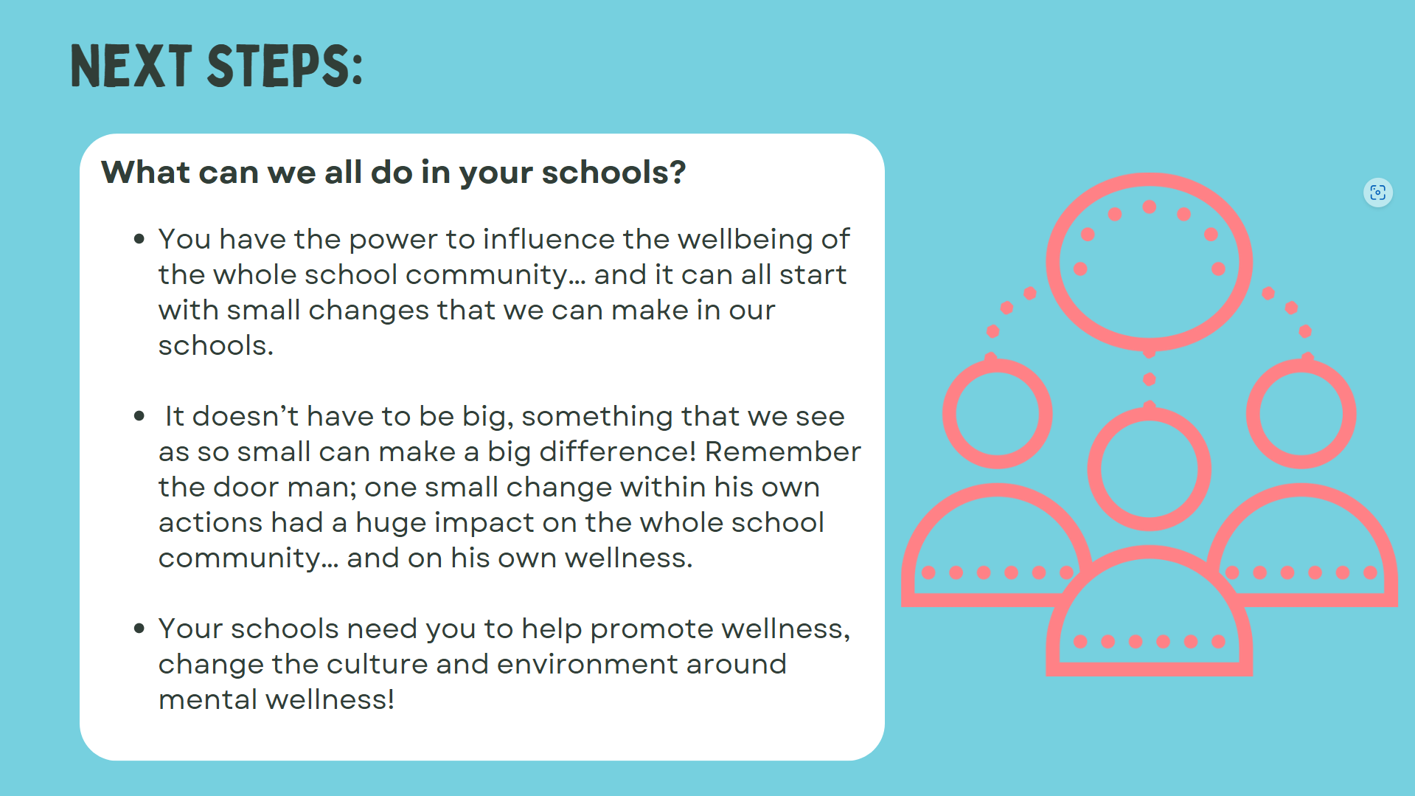

Slide 75
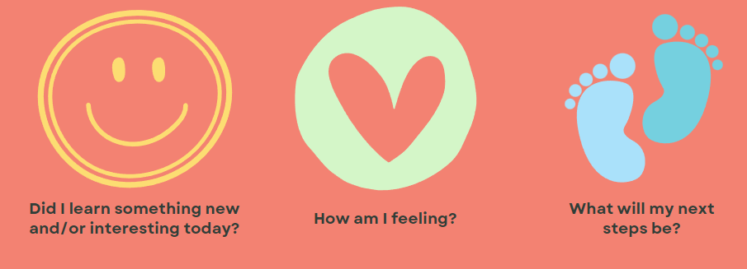
How did this session feel for you?
Insert virtual / in-person eval instructions

Slide 76





I thought...
What are you taking away from today?
I’m going to consider...
Notes:
What is one thing you’re taking away from today
Sticky notes, post onto board and review as group

Slide 77

Questions? Here’s where to go:
  Teacher contact info
  Public health unit contact info
  Kids Help Phone @ 1-800-668-6868
  RNAO Mental Health & Substance Use program at mhsu@RNAO.ca
Thank you!

Slide 78

Thank you

Slide 79
Break Time!

