Slide 1


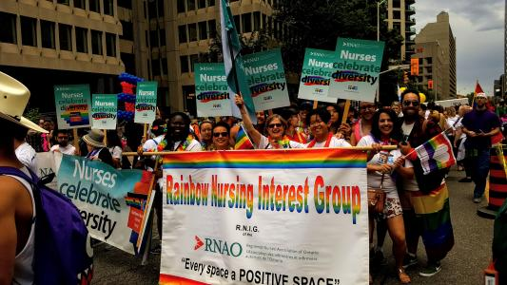
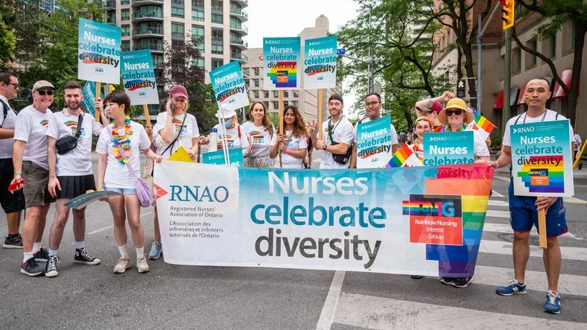

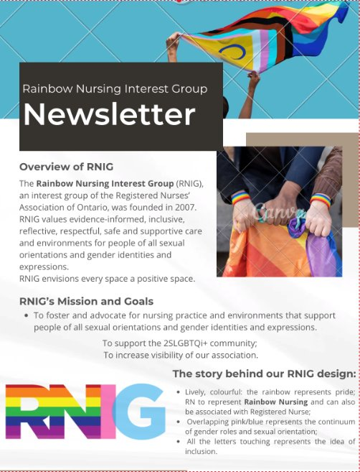

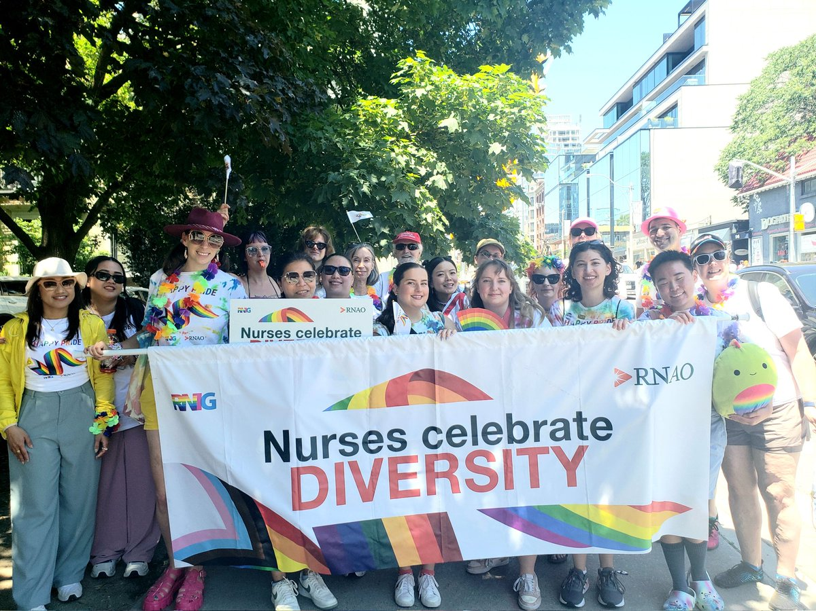
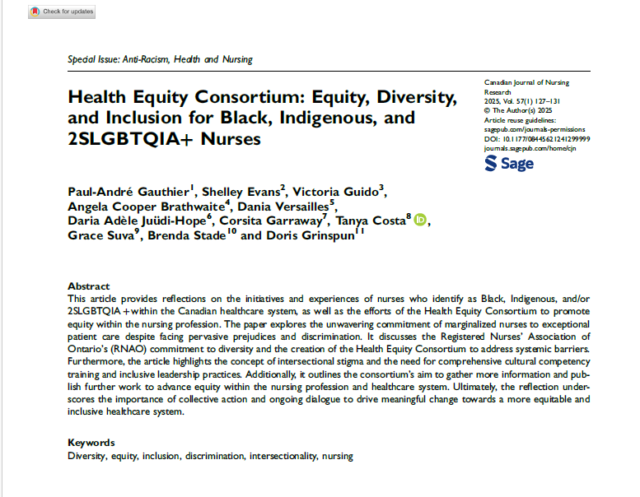
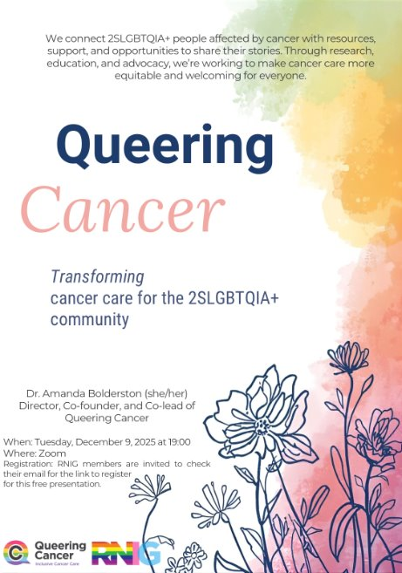
Macawille, L.J. & Boamah, S.A.
Pride in Action:
Unlocking the Power of Interest Groups to Drive Meaningful Change
Leo Jhon Rey Macawile, RN, CCRN, MScN (student) 1
1 Rainbow Nursing Interest Group (RNIG), Registered Nurses’ Association of Ontario (RNAO)
About the Rainbow Nursing Interest Group
Success Stories: Key Achievements
Call for Collaboration and Partnership Opportunities
Previous Pride Parade
The Rainbow Nursing Interest Group (RNIG), founded in 2007 as part of the Registered Nurses’ Association of Ontario (RNAO), champions safe, inclusive, reflective, and evidence‑informed nursing practice for people of all sexual orientations, gender identities, and gender expressions.​
RNIG envisions every space as a positive space, where all individuals are respected, supported, and affirmed.​
Mission​
To foster and advocate for nursing practice and environments that honour and support people of all sexual orientations, gender identities, and gender expressions.​
Goals​
To support the 2SLGBTQi+ community;​
to increase visibility of our association.​
(Los Angeles County Department of Mental Health, 2022)
Participation in Pride Events​
We continuously participate in Pride Month events. With the generous support of RNAO, RNIG members and executives take part freely and openly, celebrating with joy, pride, and a strong commitment to visibility and inclusion.​
​
2. Educational Webinars on 2SLGBTQIA+ Health​
We continuously participate in Pride Month events. With the generous support of RNAO, RNIG members and executives take part freely and openly, celebrating with joy, pride, and a strong commitment to visibility and inclusion.​
​
3. Keeping Our Community Informed​
Regularly creating and circulating newsletters to keep our members informed about past and upcoming events, opportunities, and relevant academic articles or grey literature. These updates help ensure our members stay educated and up to date on current issues, concerns, and successes within the 2SLGBTQIA+ community.
Collaboration among chapters and interest groups is essential for advancing advocacy, facilitating knowledge exchange, and addressing systemic barriers to equitable care. ​
Now more than ever, we strive for deeper partnerships that unite our expertise, support and protect one another, and ensure we deliver the high‑quality, inclusive care our patients need and deserve, working together as a powerful, unified force for change.​
With strong partnerships and collaboration, we work to challenge the invisibility and silencing faced by 2SLGBTQIA+ people, promote evidence‑informed nursing care that reflects their needs, and advocate for clients, their loved ones, and communities, while equipping nurses with the resources, support, and knowledge needed to foster truly inclusive healthcare environments.
Canadian Institute for ​
Health Information. (n.d.-a)​
Conclusion
Add your information, graphs and images to this section.
Our Vision for the Future
Envisioning healthcare environments that are genuinely inclusive requires confronting the structural barriers that impede equitable care for 2SLGBTQIA+ communities and the nurses who serve them. RNIG calls for a system in which visibility, advocacy, and respect are not aspirational ideals but foundational principles, shaping policies and practices that enable all individuals to access care with dignity and safety.​
​
It is our hope that we continue to educate and impact more lives through our initiatives. With support from RNAO and the Best Practice Guidelines (BPGs), we aim to see more academic institutions and workplaces intentionally implementing these recommendations to foster safer, more inclusive spaces for all.
Collective Power: How Interest Groups Can Elevate and Empower Nurses
Interest groups elevate and empower nurses by creating supportive communities, amplifying marginalized voices, and advancing evidence‑informed education. They strengthen advocacy skills, promote inclusive practices, and connect nurses with resources that enhance confidence, leadership, and impact, enabling nurses to drive meaningful, system‑level change in healthcare.​
​
We are witnessing in real time what is happening in the United States, and how decades of progressive hard work have been undone in a matter of weeks or months. Political events like this rarely remain isolated; they often spread and influence regions far beyond their borders, especially neighbouring countries.​
Now more than ever, interest groups must think critically and strategically to combat disinformation and misinformation, while continuing to educate and empower fellow nurses and the broader community about what is at stake.
The Presenter
Contact and Social Media
Leo Macawile (he/they) is a registered critical care nurse at Canada’s number one hospital, with nearly two and a half years of experience as an ICU nurse. As a graduate student, Leo has worked as both a Teaching Assistant (TA) and Research Assistant (RA). Currently, Leo is a RA volunteer with Thrive Group. Leo is being supervised by Dr. Sheila Boamah, an Associate Professor at the School of Nursing. Beyond academia, Leo is actively involved in the nursing community, serving as Events Chair for the SIGMA Lambda Pi At-Large Chapter, Executive Network Officer and President Elect (effective August 2026) for the Rainbow Nursing Interest Group (RNAO), and Mentorship Co‑Chair for the Alliance of Filipino Nursing Professionals in Canada.
Email: macawill@mcmaster.ca
Email: Rainbow-RNIG@hotmail.com​
Facebook: Rainbow Nursing Interest Group – RNIG​
Join Us: Log in to your RNAO account and join RNIG Interest group

