Slide 1

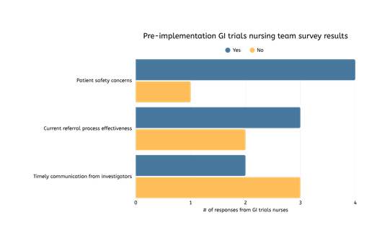
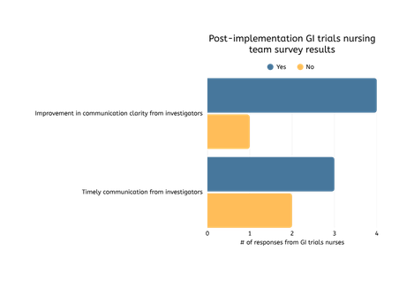
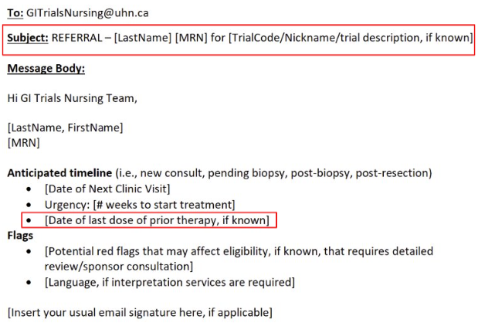





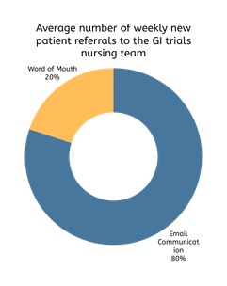
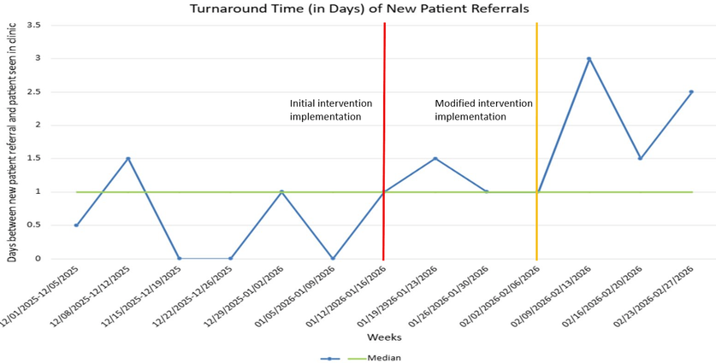
REFERRALS REIMAGINED: STREAMLINING NEW PATIENT REFERRAL PROCESS WITHIN THE GASTROINTESTINAL (GI) SITE AT THE CANCER CLINICAL RESEARCH UNIT (CCRU)
A Quality Improvement (QI) Initiative with the Toronto Academic Health Sciences Network Practice (TAHSNp) Health Professions Innovation Fellowship Program
Author
Affiliations
Dowon Choi RN, BScN, MN-HSLA student
Heather Cole, Senior Clinical Research Manager
Cancer Clinical Research Unit (CCRU), Princess Margaret Cancer Centre, University Health Network
Introduction & Background
Time toxicity refers to the cumulative time burden experienced by patients and their families while navigating their cancer care journey and represents an important quality-of-care issue in patients participating in clinical trials. Within clinical trials, protocol-driven requirements often limit scheduling flexibility, increasing system-related demands on patients (Stevens et al., 2025). Moreover, trial-specific screening processes introduce additional steps beyond standard-of-care, contributing further to time toxicity. At the gastrointestinal (GI) site within the Cancer Clinical Research Unit (CCRU) at Princess Margaret Cancer Centre (PM), the absence of a standardized process for communicating referrals of potential trial candidates between investigators and trial nurses has further exacerbated time toxicity - resulting in delays in coordinating time-sensitive screening assessments, safety risks associated with approaching ineligible patients, and increased redundant administrative workload for nursing.
Methods
Problem identification: a scoping review was done to obtain a better understanding of time toxicity in oncology clinical trials. The scope of the project was narrowed and objectives were defined.
Results
Local context: A current state analysis was performed through observation. Process mapping, fish bone diagram, and 5 Whys were employed to conduct a root cause analysis and a needs assessment
The initial needs assessment demonstrated inconsistencies between investigator-to-nurse communication. Pre-implementation survey results from the GI trials nurses reiterated workflow pressure and time constraints related to screening new patients. After piloting the new communication tool, timely communication did improve as evidenced in the run chart, however, it did not meet the 15% weekly aim. Despite the preliminary results, post-implementation survey results from the GI trials nurses suggest improved clarity and satisfaction.
Design: change champions were identified. Communication tool was built in the form of an email template with pre-defined fields validated by the GI trials nurses. Pre-implementation surveys were completed by the nurses.
Objective
The purpose of this quality improvement (QI) initiative was to focus on an aspect of avoidable time toxicity through the implementation of a communicational tool - reducing avoidable system friction, empowering frontline teams, and transforming patient experience. The aim of this project was improve weekly new patient referral communication from investigators to the GI trials nursing team by 15% by March, 2026.
Pilot: communication tool was piloted using the Plan-Do-Study-Act (PDSA) cycle; progress was monitored on a weekly basis and tool was modified based on feedback from both investigators and nurses.
Conclusion
Evaluation: data analysis occurred; findings were reported and shared with stakeholders. Robust sustainability and scalability plan was developed to ensure ongoing intervention implementation.
The variability in the uptake of the communication tool from the investigators limited generalizability of results. Nevertheless, the new patient referral communication tool is pragmatic; the intervention was patient-centered with the focus on minimizing non-therapeutic burden associated with time toxicity while streamlining clinical nursing research operations using a bottom-up approach. The primary challenge was inconsistent investigator engagement. A lessons learned was to initiate early investigator buy-in. Recommendations include maintaining the use of the standardized communication tool and pursue the use of technology to centralize all referrals, and assess scalability by disseminating the communication tool to other disease sites within CCRU.
Measures
The outcome measure was the turnaround time taken for the trials nurses to receive a new patient referral using the new communication tool. Process measures included the number of patients identified as a clinical trial candidate through the referral process and the weekly % of completed communication tool by investigators. The balancing measure was nursing satisfaction with the implementation strategy.
Key Sources & Acknowledgements
Stevens, S. X., El-Katateny, E., De Abreu Lourenço, R., Booth, C. M., Shaw, J., & Vardy, J. L. (2025). “The cancer is my life”: patient and caregiver perceptions of the time toxicity of palliative systemic cancer treatments for advanced gastrointestinal cancers. Supportive Care in Cancer, 33(7), Article 564. https://doi.org/10.1007/s00520-025-09621-4​
Nursing Collaborative Academic Practice (CAP) Fellowship, University Health Network (UHN) Foundation; CAP Executive Leadership; Health Professions Innovation Fellowship Program & CAP Faculty
Cancer Clinical Research Unit (CCRU) Leadership; Gastrointestinal (GI) trials nursing team; GI trials team

