Slide 1
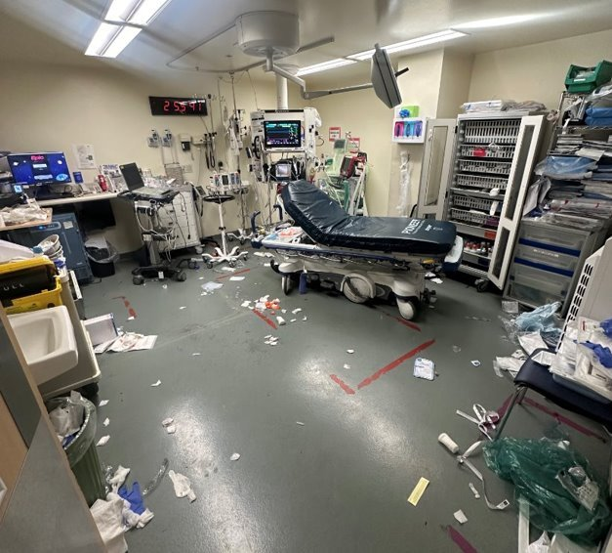
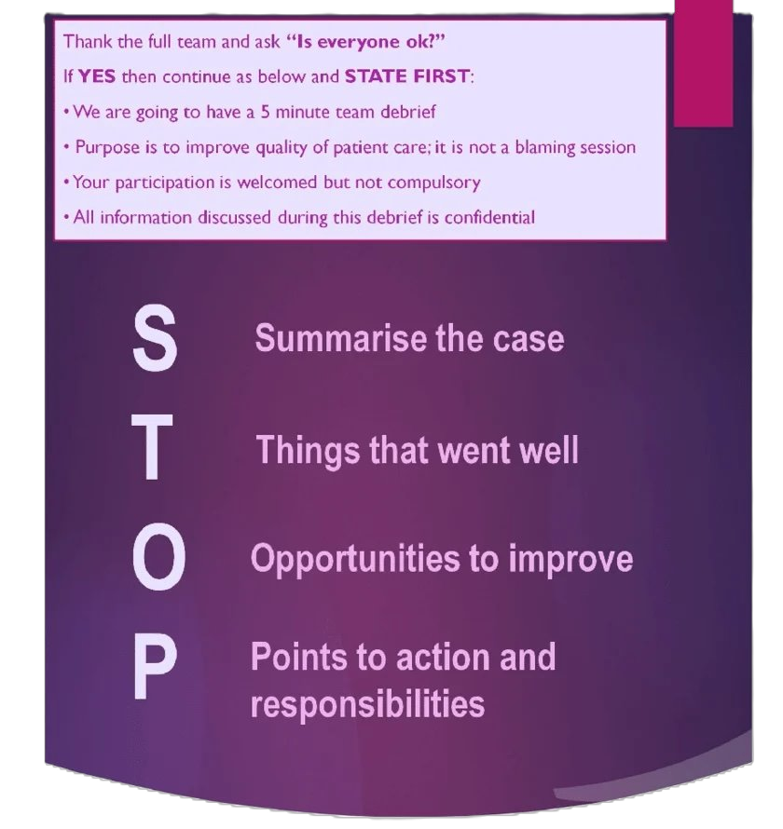
Enhancing toronto western ed practice & team wellness through structured post-resuscitation debriefing
BACKGROUND
PROJECT & AIM
METHODS
RESULTS
CONCLUSION
In September 2025: 11 cardiac and respiratory arrests occurred.
No debriefing forms were completed.
An electronic debrief tool was created using the peer-reviewed adapted-STOP5-framework (Walker et al., 2020).
Pre-intervention and post-intervention surveys were conducted to measure confidence and debrief completion rate was collected.
Only 19% of the nurses (n=42) that completed our initial pre-survey stated they were confident in leading a debrief VS in our post-survey results, 70% (n=39) of nurses stated they were confident in leading a debrief, which shows a 51% increase which surpassed our goal of 10%. Debrief completion rate also went from 0% to 86%
Our results show that implementing PRD requires visible leadership support, workflow alignment, and accessible tools. Integrating a consistent, nurse-led debriefing process strengthens resilience, enhances team cohesion, empowers nursing staff, and promotes a culture of safety and continuous learning.
Emergency department (ED) nurses consistently encounter highly acute and emotionally challenging events.
Post resuscitation debriefing (PRD) is a structured reflective discussion following traumatic events, designed to create a safe space for honest dialogue that strengthens both individual resilience and team cohesion by fostering trust and promoting coping strategies, while reducing occupational stress.
AIM : to increase nurse confidence in conducting post-resuscitation debriefs by 10% in Toronto Western Hospital ED by March 2026.
Walker, C. A., McGregor, L., Taylor, C., & Robinson, S. (2020). STOP5: a hot debrief model for resuscitation cases in the emergency department. Clinical and experimental emergency medicine, 7(4), 259-266. https://doi.org/10.15441/ceem.19.086

