Slide 1


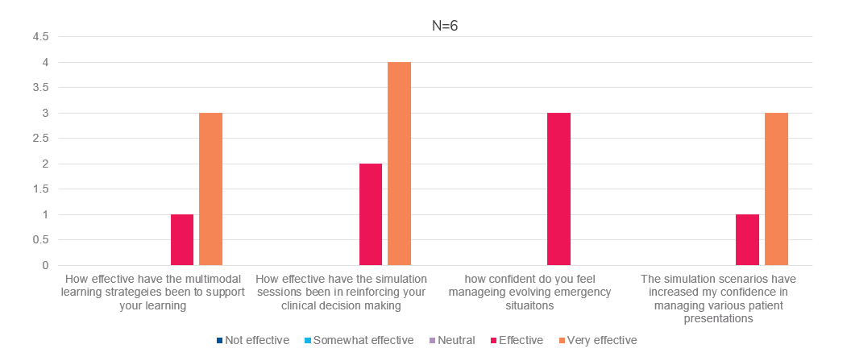
Building a Sustainable Emergency Nursing Workforce: Outcomes of a Multimodal, Competency-Based Orientation Program
Seema Klotia, RN, BScN, MScN; René Samuda, RN, BScN, MDEM, ENCC
Purpose
To evaluate the impact of a revised Emergency Department (ED) Nurse Orientation Program on nurse retention, role confidence, and professional well-being, through the implementation of standardized onboarding pathways, National Emergency Nurses Association (NENA)-aligned competency tools, and Multimodal teaching strategies across three hospital sites
Conclusions
Clinical Competence & Readiness: By integrating multimodal learning and simulation, the program successfully builds long-term critical thinking and confidence, ensuring nurses are clinically prepared to manage high-acuity, evolving emergency situations and diverse patient presentations
Psychological Safety & Well-Being: The structured, competency-based framework reduces cognitive overload and early-role stress, fostering a safer transition to practice that enhances professional engagement and job satisfaction
Sustainability & Retention: Opportunities for hands-on practice and supported leadership development reinforce nurse resilience, functioning by strengthening the foundational factors that are known to improve early-career retention in high-pressure environments
Methods
Framework and Scope: A mixed-methods evaluation (July–September 2025) utilized the Kirkpatrick Model (Levels 1–4) to assess 14 new staff onboarded across three emergency sites, specifically excluding NGGs, RPN-to-RN transitions, or those returning from leave to isolate the impact on completely new hires
Methodology and Data: Focused on early career support and workforce sustainability, data was gathered via end-of-orientation evaluations, LMS checkpoints, pre/post-testing, case-based learning, simulation performance, preceptor feedback, and self-assessments of confidence and preparedness using NENA competency tool.
Post-Orientation Follow-up: Three-month post-orientation follow-up evaluations were conducted to provide a clear and focused picture of the transition-to-practice experience and intent to remain for this specific cohort
Results
Performance and Readiness: All 14 newly hired nurses completed the updated orientation, with 100% achieving < 80% on LMS knowledge checkpoints and final arrhythmia testing, indicating improved clinical confidence and readiness for independent ED practice
Simulation Outcomes: Participants completed six adult/pediatric simulations in a psychologically safe environment, with evaluations (N=7–22) showing increased comfort with high-acuity scenarios and reinforced clinical decision-making
Transition and Well-Being: Qualitative feedback noted reduced anxiety and positive transitions via hands-on practice and structured support, while identifying needs for more pediatric medication practice and simulation days
Long-Term Impact (Level 4): Data from 6 of the 7 staff hired in July and August—collected after three months on the unit—showed very positive results, with most responses rated as "effective" or "very effective" regarding the program's long-term impact
Next Steps
Longitudinal Evaluation: Analyze six-month post-orientation evaluation data, retention rates (July–January), and Datix incident reports to measure the program's long-term impact on clinical safety and workforce stability
Expanded Stakeholder Feedback: Utilize the six-month SurveyMonkey process to gather feedback from existing staff while incorporating Resus and Triage class data to further refine and evaluate the effectiveness of the revamped orientation

