Slide 1

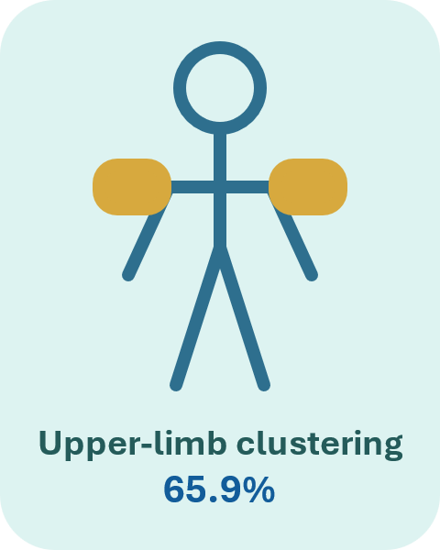
Bruise Pattern Review to Inform Safer Transfers and Positioning in Long-Term Care：
A Quality Improvement Initiative
Lindsey Liu, PhD, RN, CNCCP (C); Maria Acdal, BScN, RN
A retrospective review of 41 bruising events identified a strong upper-limb pattern with immediate implications for safer transfers, positioning, and staff coaching.
Background, Aim and Methods
Results Snapshot
Practice Implications
Background
Why this matters
41
4.37
92.7%
14.6%
Bruise pattern data can be translated into targeted strategies for safer resident handling, particularly by improving upper-limb protection during transfers and positioning.
Bruising is a common safety concern in long-term care and may reflect preventable injury during routine transfers, assisted mobility, and repositioning.
documented events
mean CPS
total care
anticoagulants
Aim
Bruise distribution by body region
1
Standardize safe transfer and positioning education
Describe bruise location patterns and selected resident factors among documented events.
Use the findings to define practical priorities for safer transfers and positioning.
2
Protect hands and forearms during routine care and assisted mobility
Methods
3
Reinforce technique through point-of-care coaching and prompts
Retrospective quality-improvement review of bruise documentation.
Variables: bruise location, anticoagulant use, care level, and CPS.
Sites were standardized into body regions: upper limb, lower limb, head/face, and trunk.
Descriptive statistics were used to identify clustering and practice relevance.
Most common specific sites
4
Use appropriate equipment and review bruise trends over time
Forearm
22.0%
Hand
14.6%
Key takeaway
Lower leg
14.6%
Wrist
7.3%
Residents requiring total care and with moderate-to-high CPS may be more vulnerable to bruising during routine handling. Upper-limb clustering highlights the need for safer transfers, positioning, and gentle handling in LTC.
Notes:
[Sources]
- Visual style references from uploaded poster examples and City of Toronto template.
- Non-trivial claim source: user-provided abstract and data in conversation.
[/Sources]

